Slide 1
Social justice advocacy and responses to campus racism: Roles, Challenges and opportunities
Rachel L. Navarro Belle Liang Lisa Y. Flores
U of North Dakota Boston College U of Missouri

Slide 2
Campus Protests Are Spreading Like Wildfire (Mother Jones)
What's Different about the Latest Wave of College Activism? (Los Angeles Times)
Epidemic of Racist Incidents (Inside Higher Education)
CAMPUS PROTESTS
AGAINST RACISM
Racism on College Campuses: Students on Where We are Now (USA Today)
University Students hold Anti-Racism Protests across U.S. (The Guardian)
Racial Discrimination Protests Ignite at Colleges across the U.S. (New York Times)

Slide 3
Organizations….are the vessels in which a society holds hard-won treasures from the past. Movements….are the process through which a society channels its energies for renewal and transformation. A healthy society will encourage interplay between the two.
(Palmer, 1998; The Courage to Teach)

Slide 4
Presentation Outline
What happened at MU, BC and UND?
  What spurred these protests?
  Outcomes
Main Concerns related to Campus Racial Climate
Issues Facing Higher Education
Challenges and Ethical Considerations
Discussion and Action Plans

Slide 5
Media analysis
Observations
Main messages
Descriptions of protests
Description of student protesters
Voices represented
Stereotypes

Slide 6
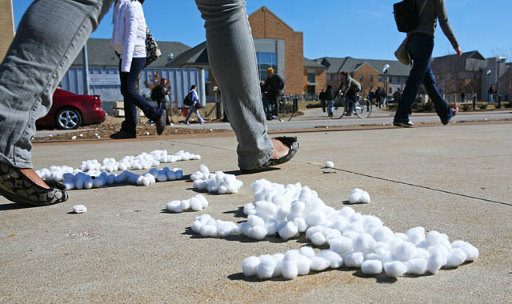
University of Missouri

Slide 7

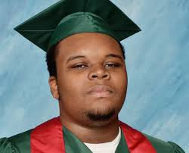

Slide 8
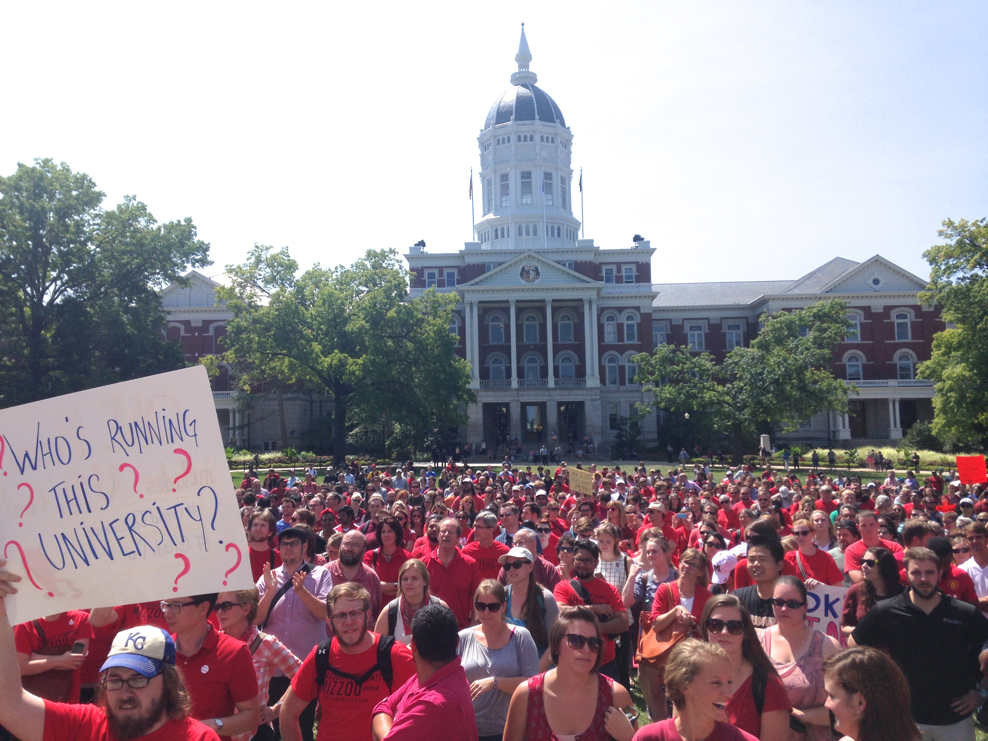
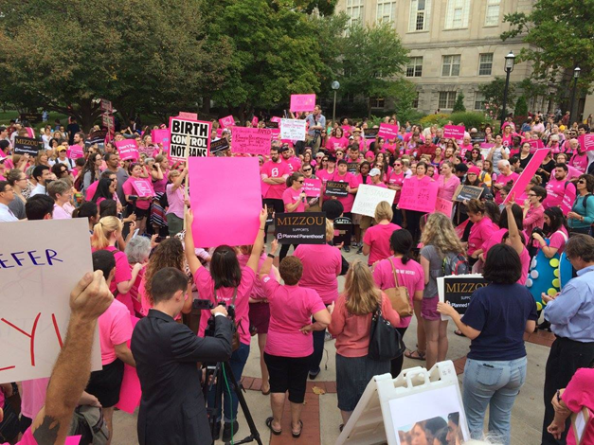


University of Missouri: Fall 2015

Slide 9
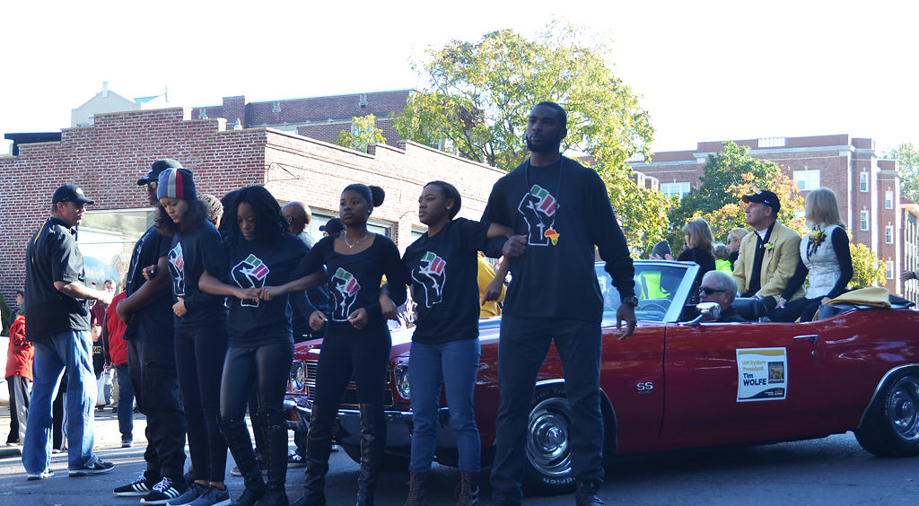
Mizzou Homecoming 2015: A turning point

Slide 10
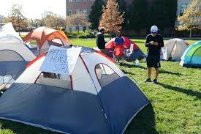
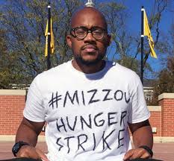
Hunger strike &
Football boycott

Slide 11
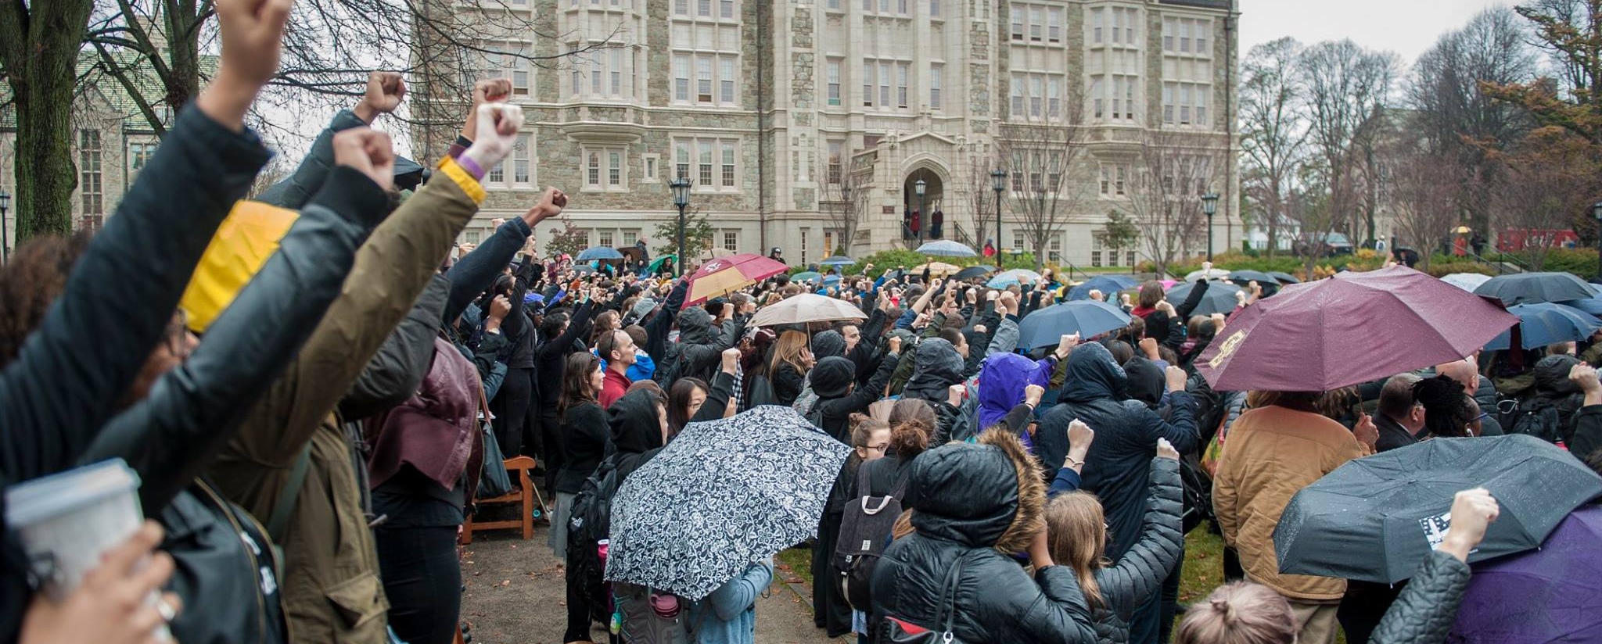
Boston College

Slide 12
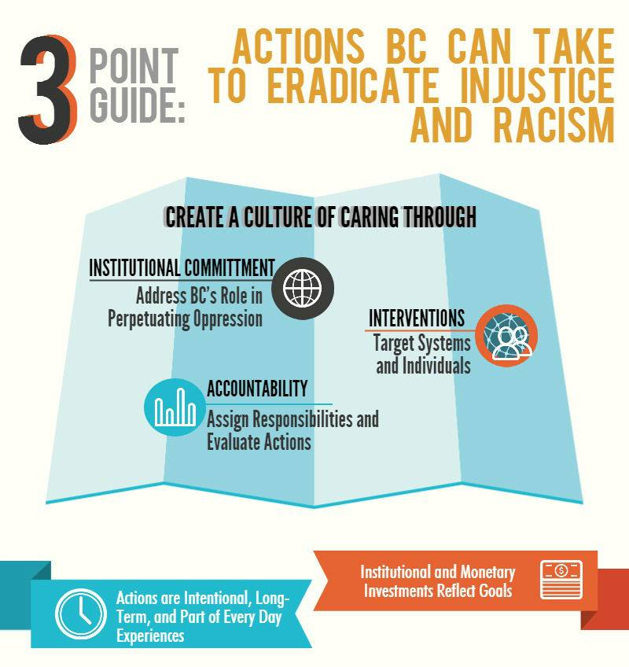
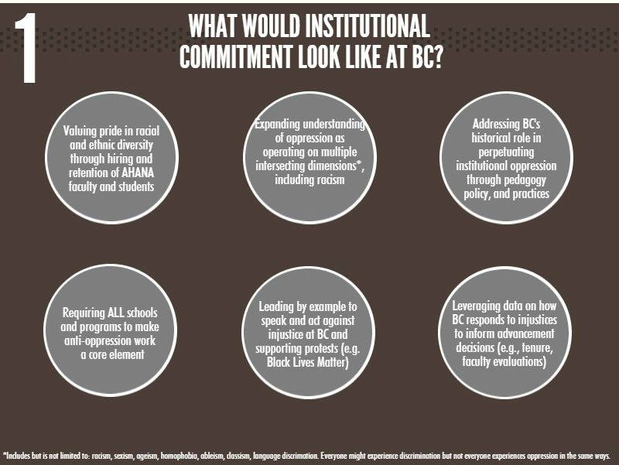
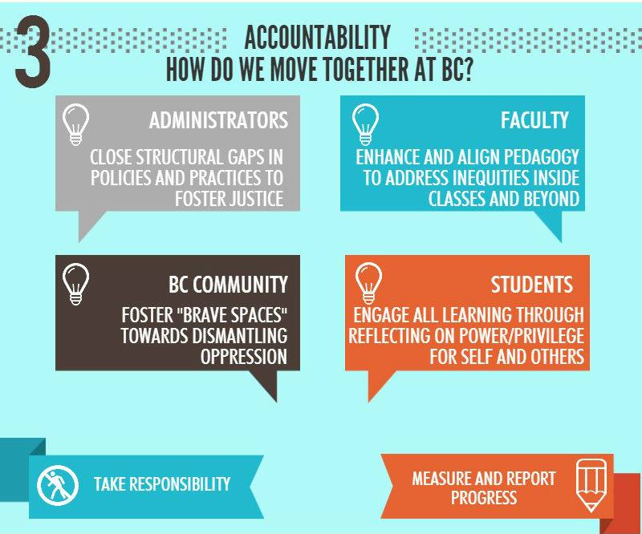
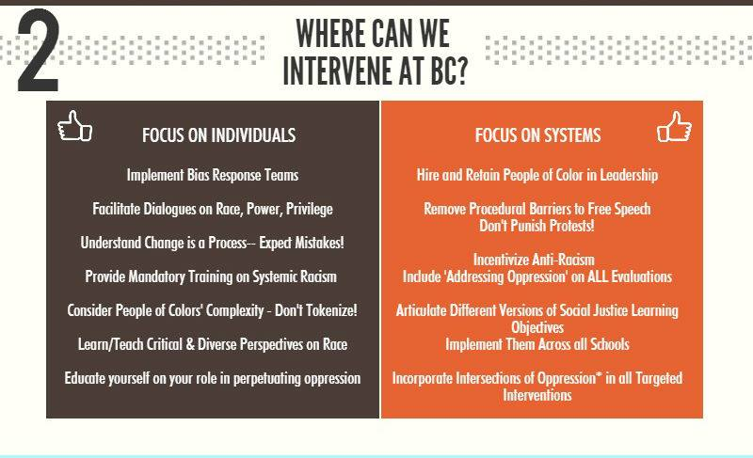

Slide 13
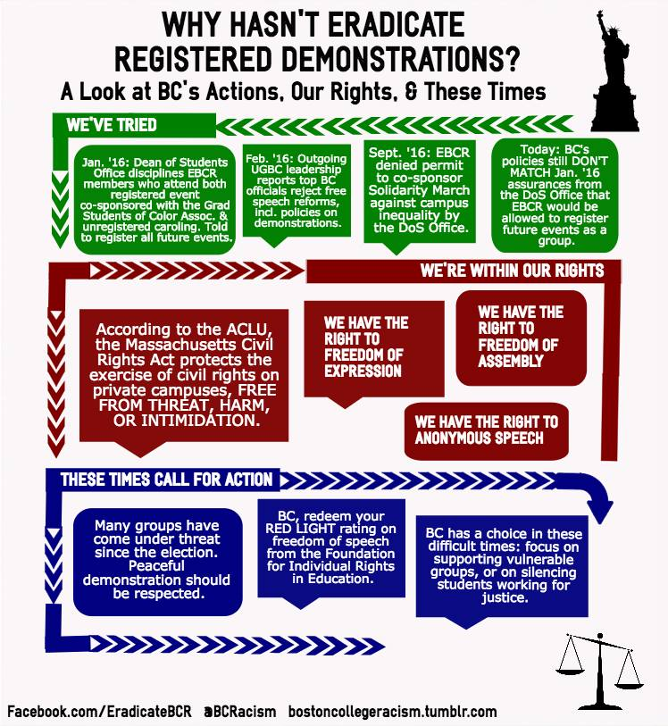

Slide 14
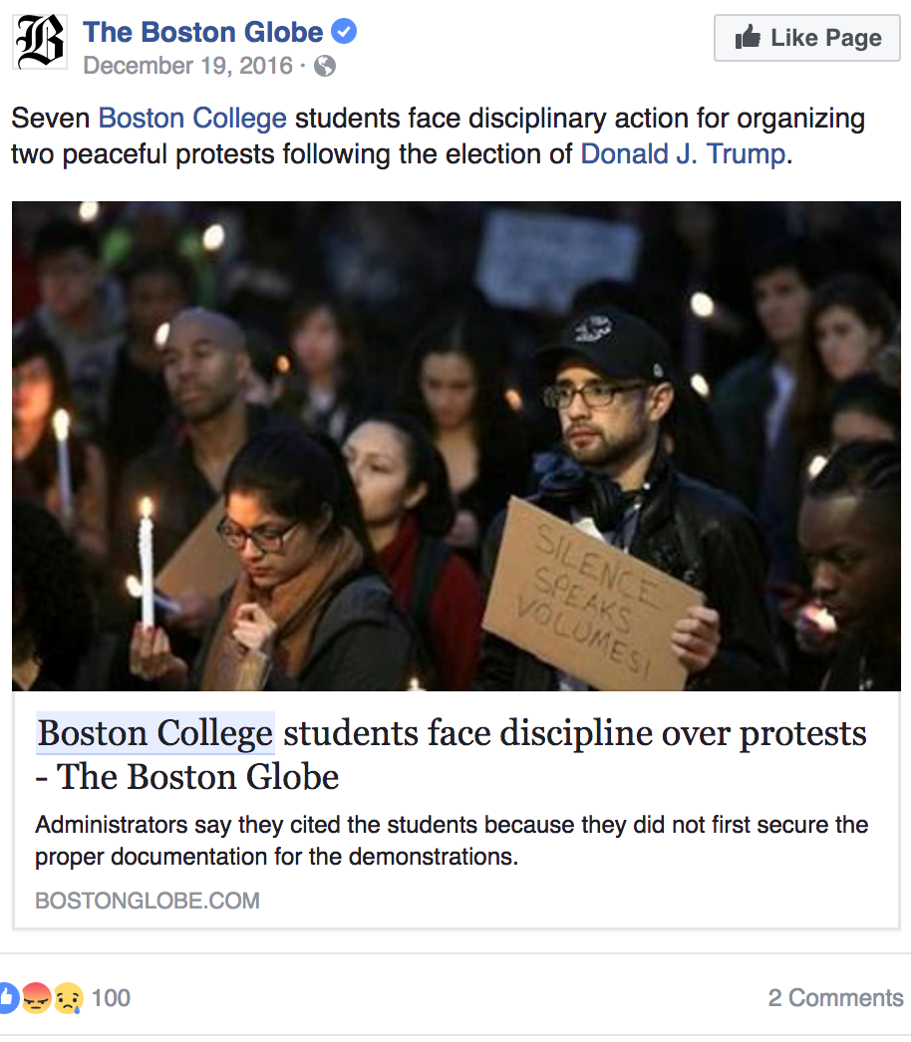
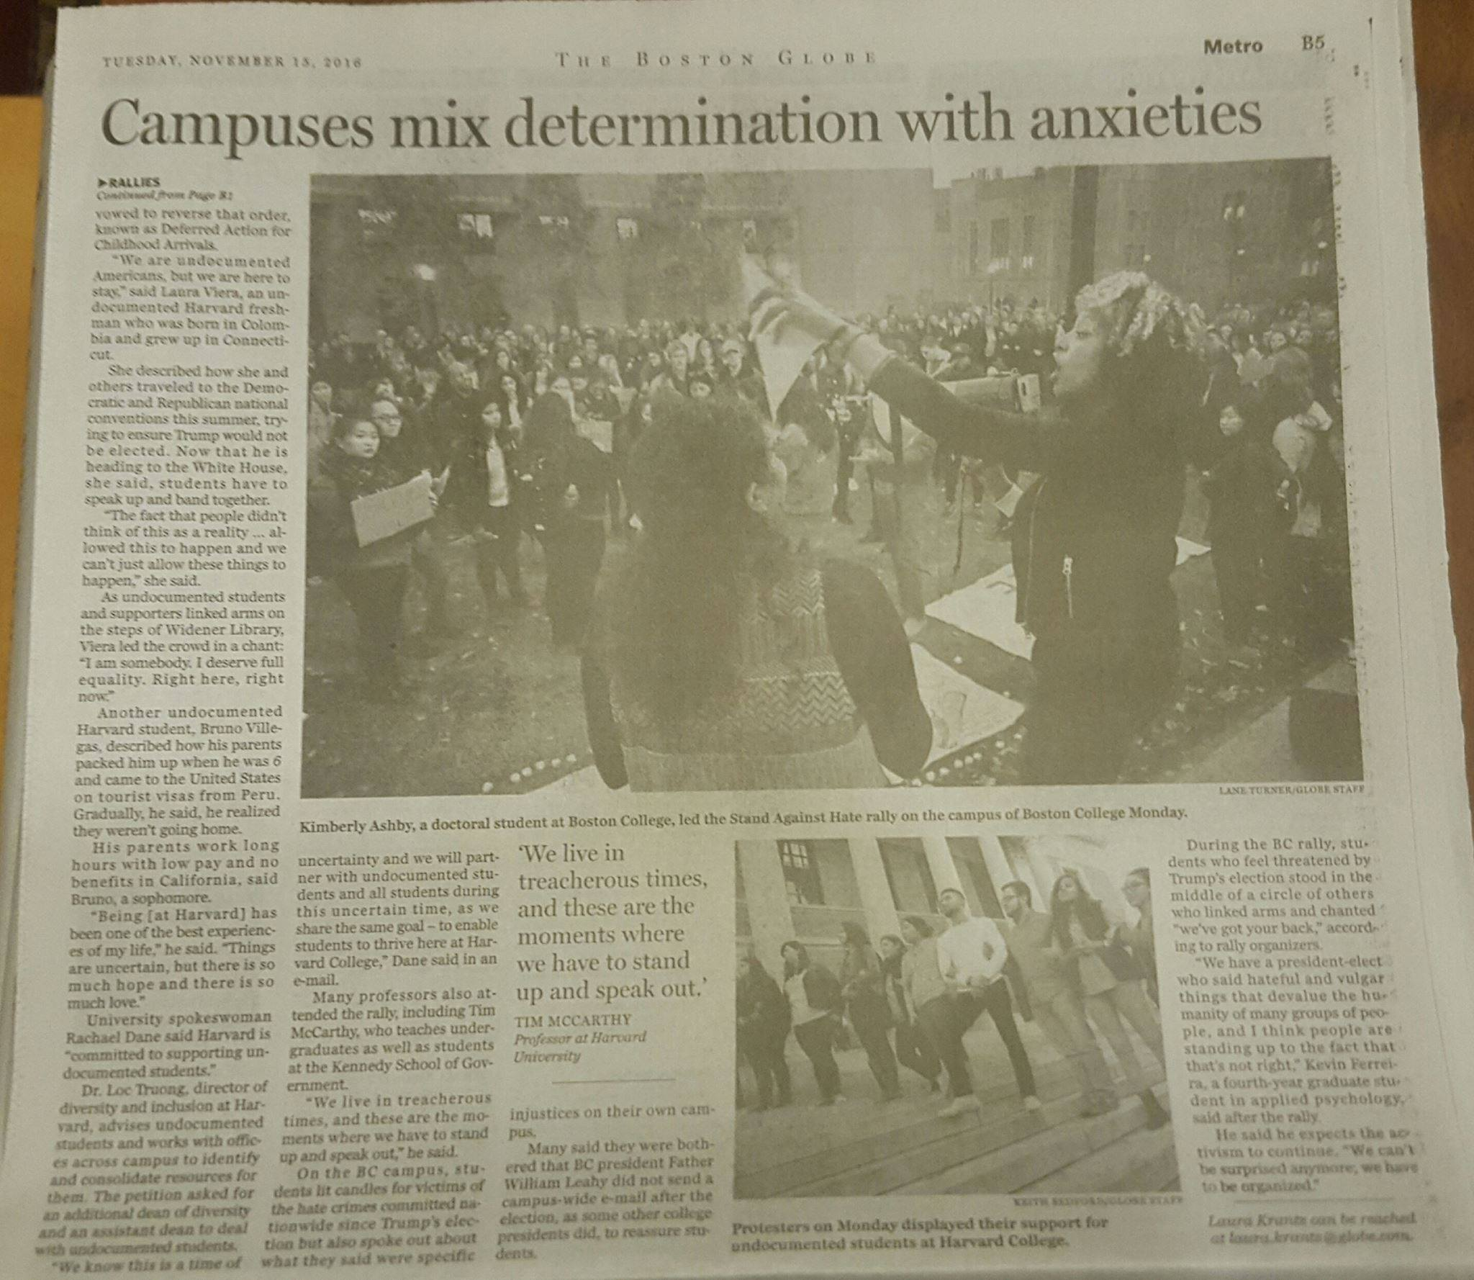
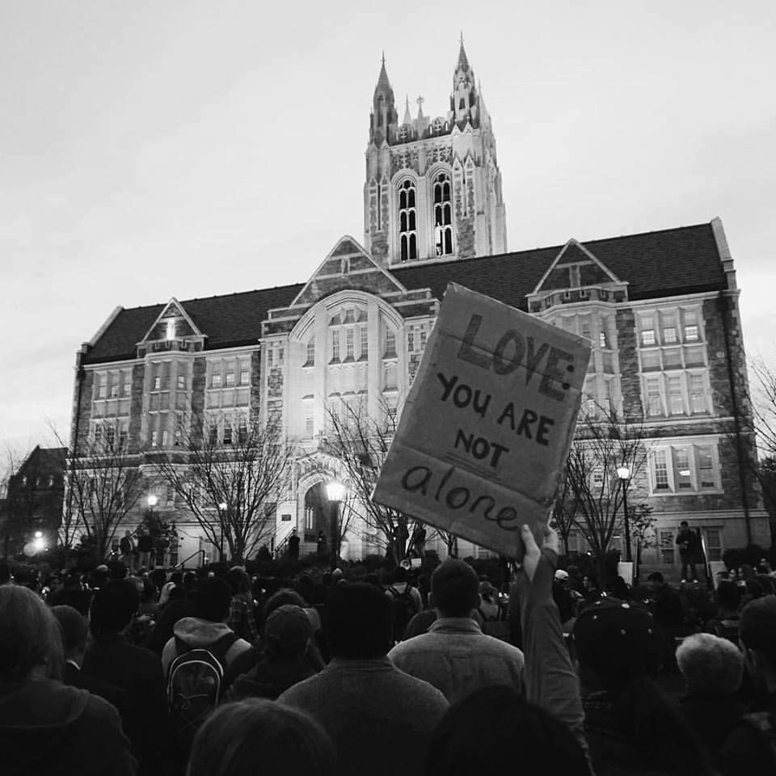
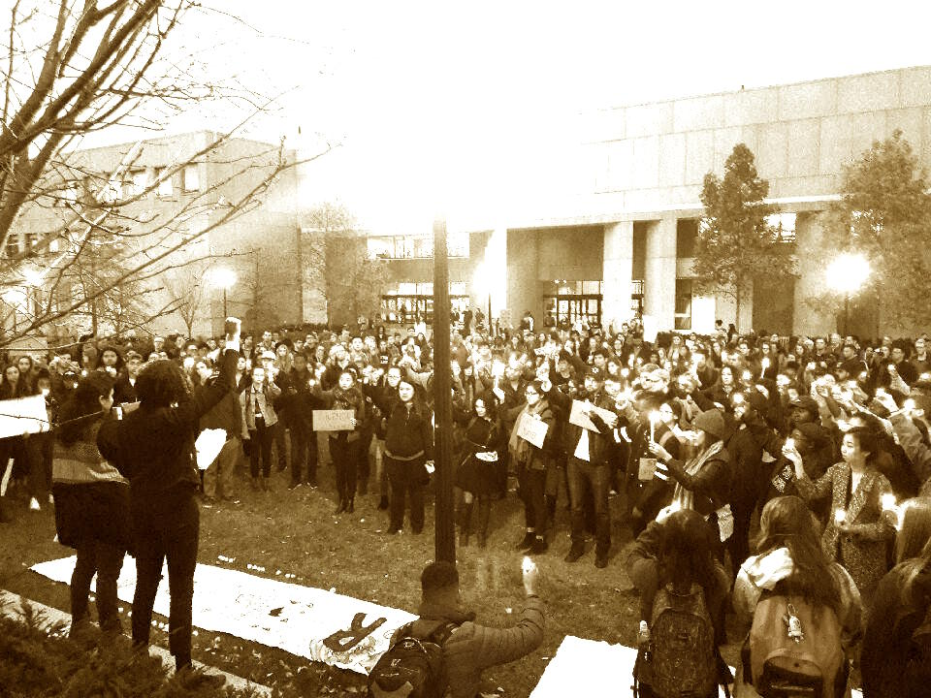

Slide 15
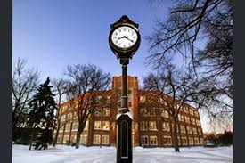
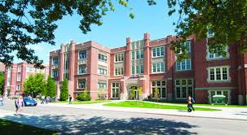
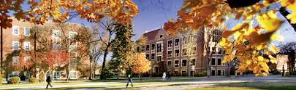
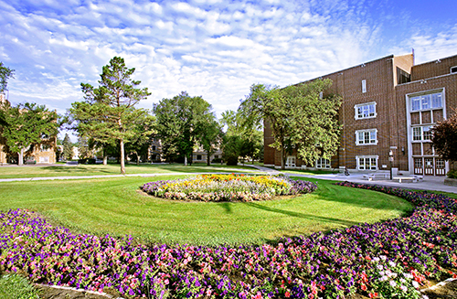
University of North Dakota

Slide 16
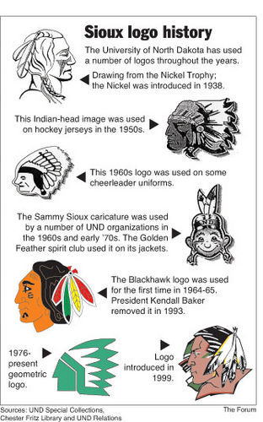
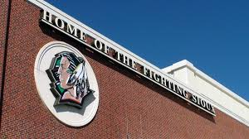
Long History of Racial Tension on Campus

Slide 17

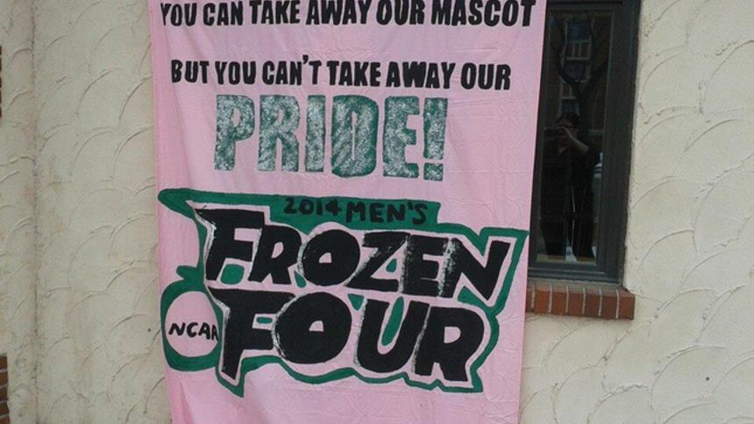


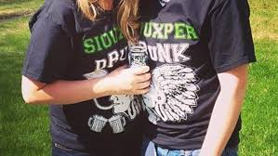

Slide 18
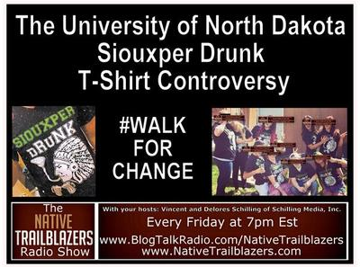
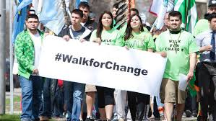
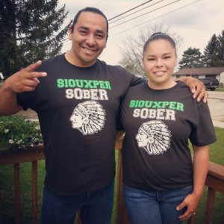
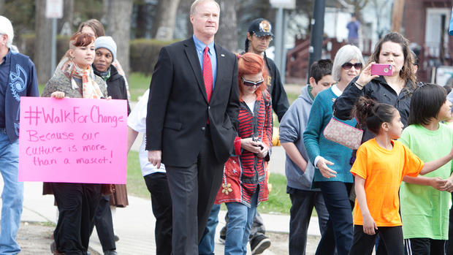

Slide 19
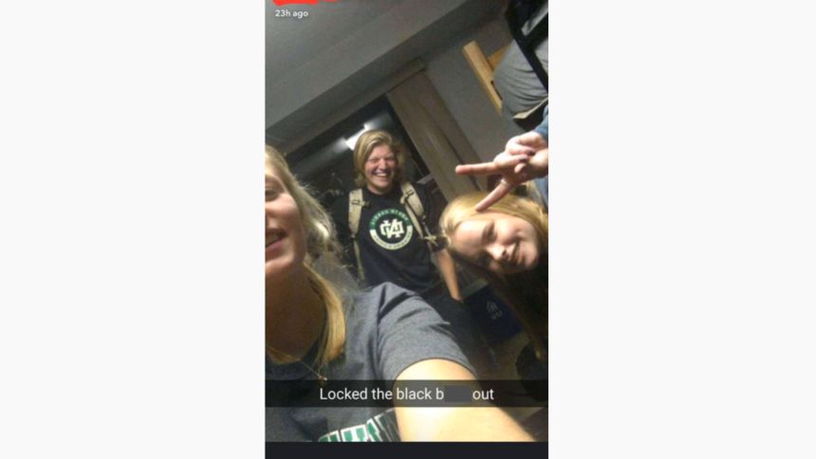
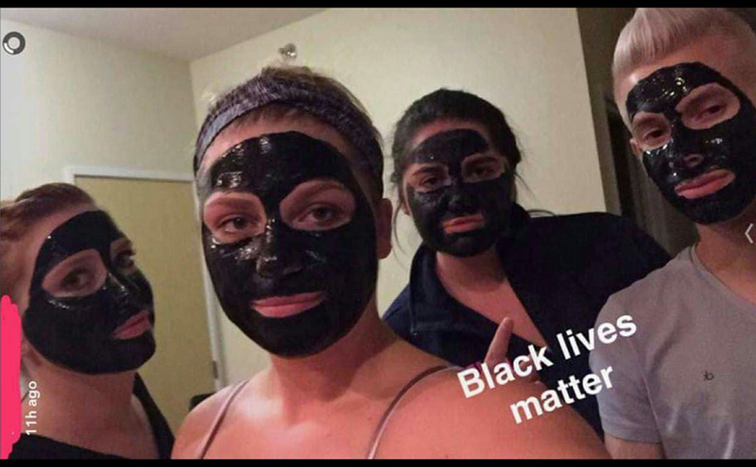
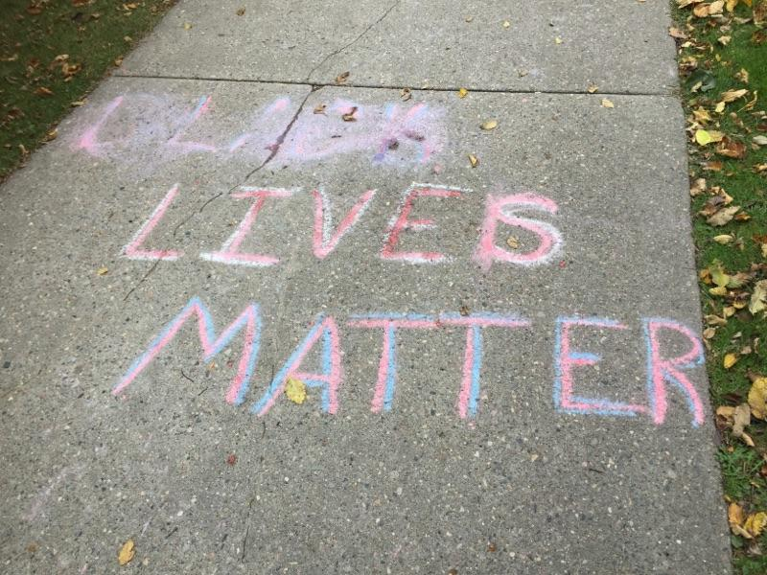

Slide 20
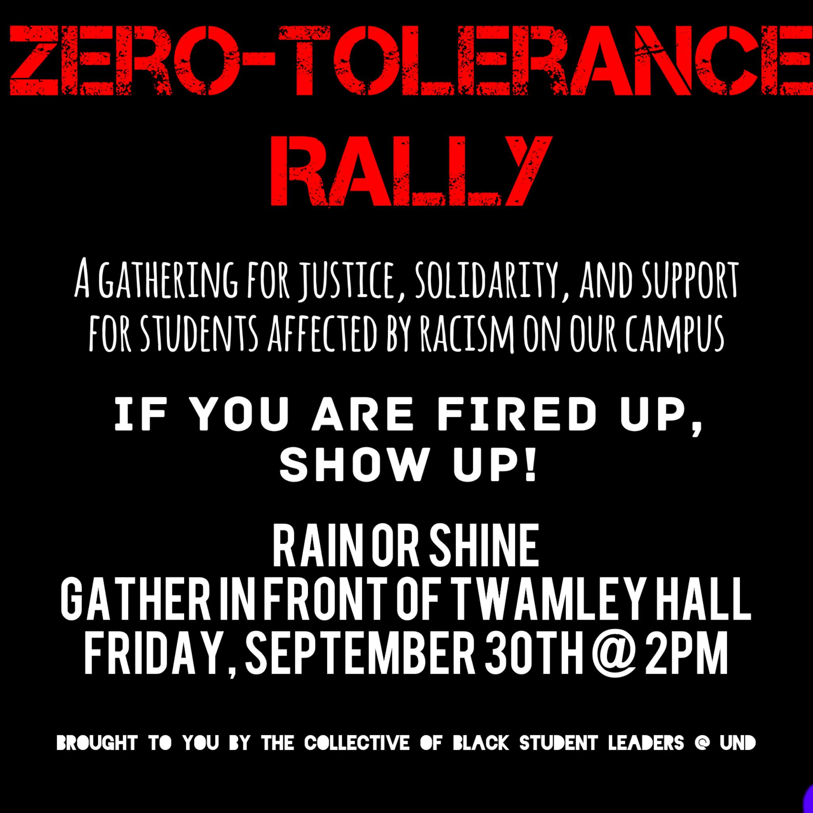


Slide 21
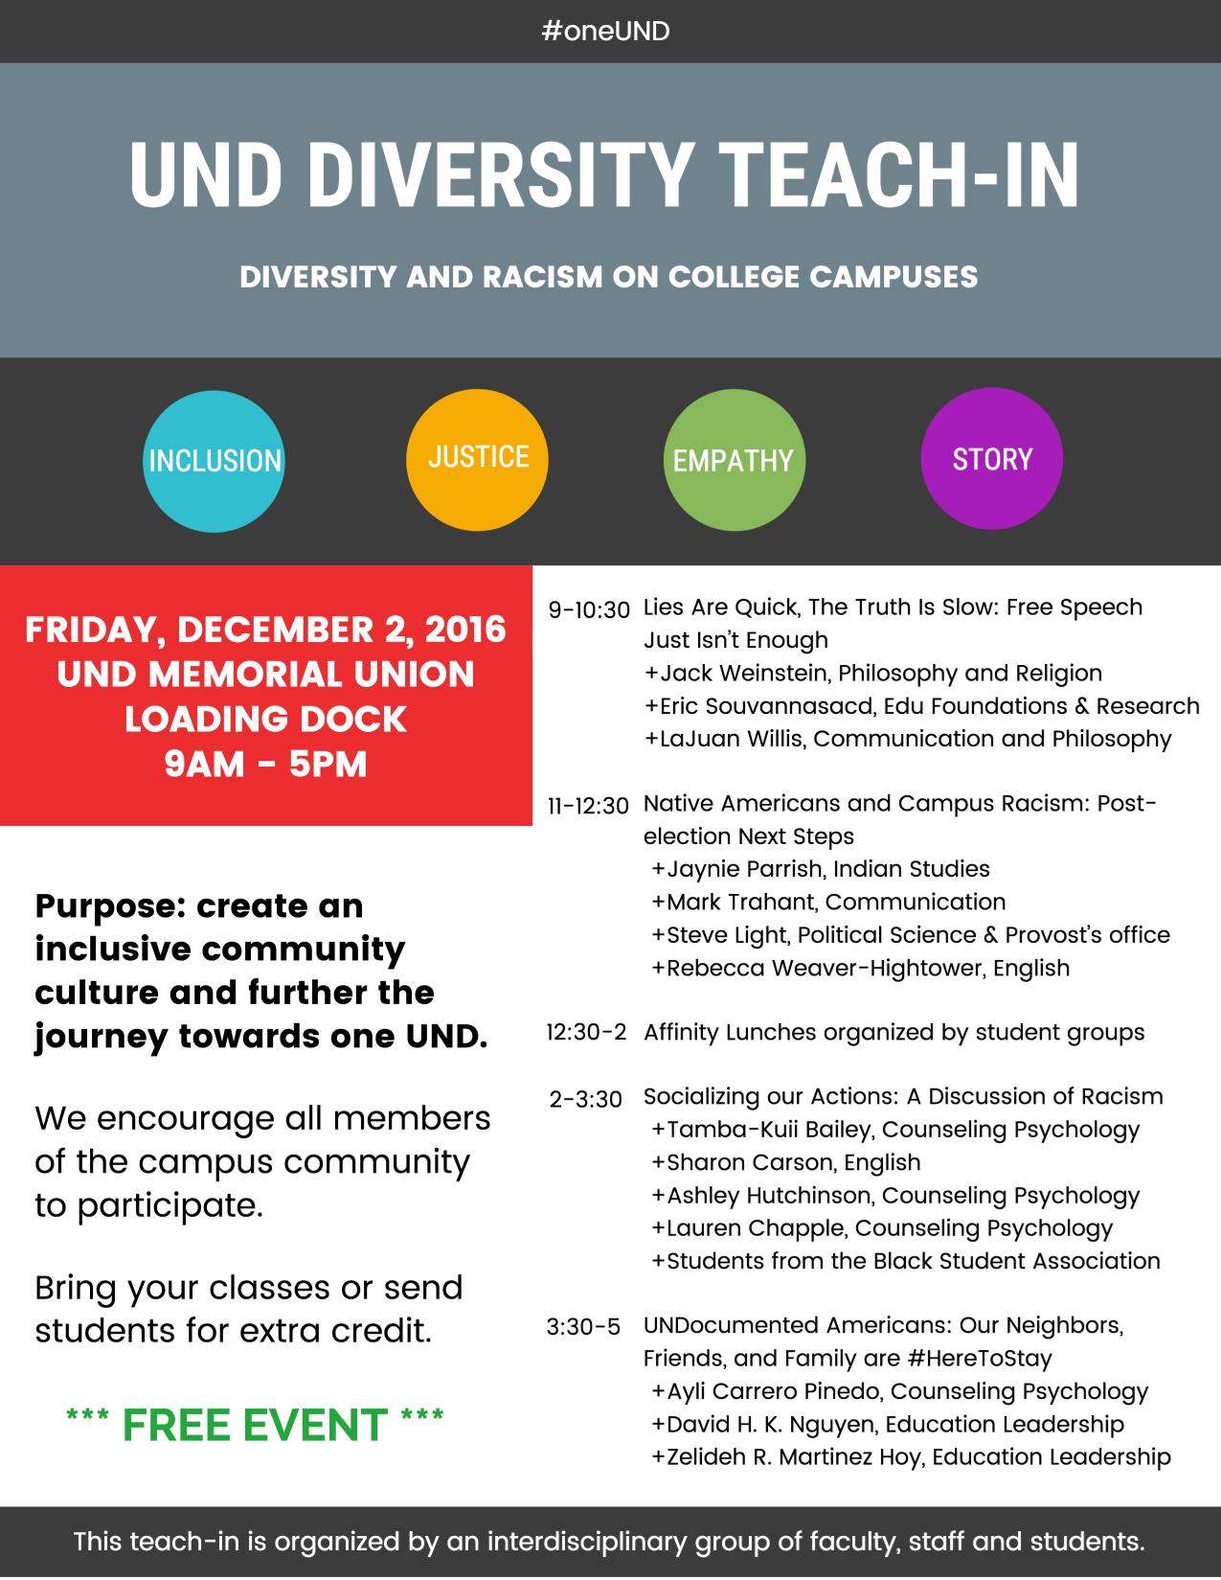
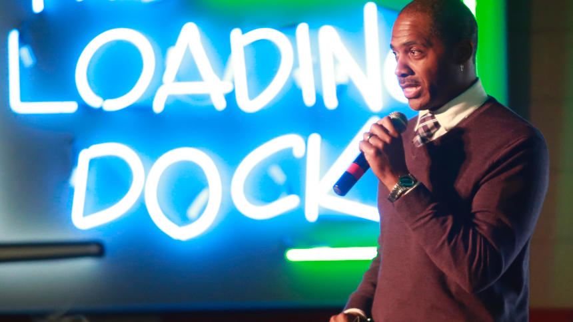
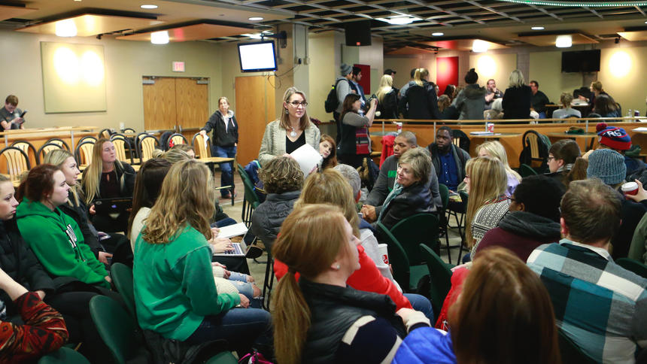

Slide 22

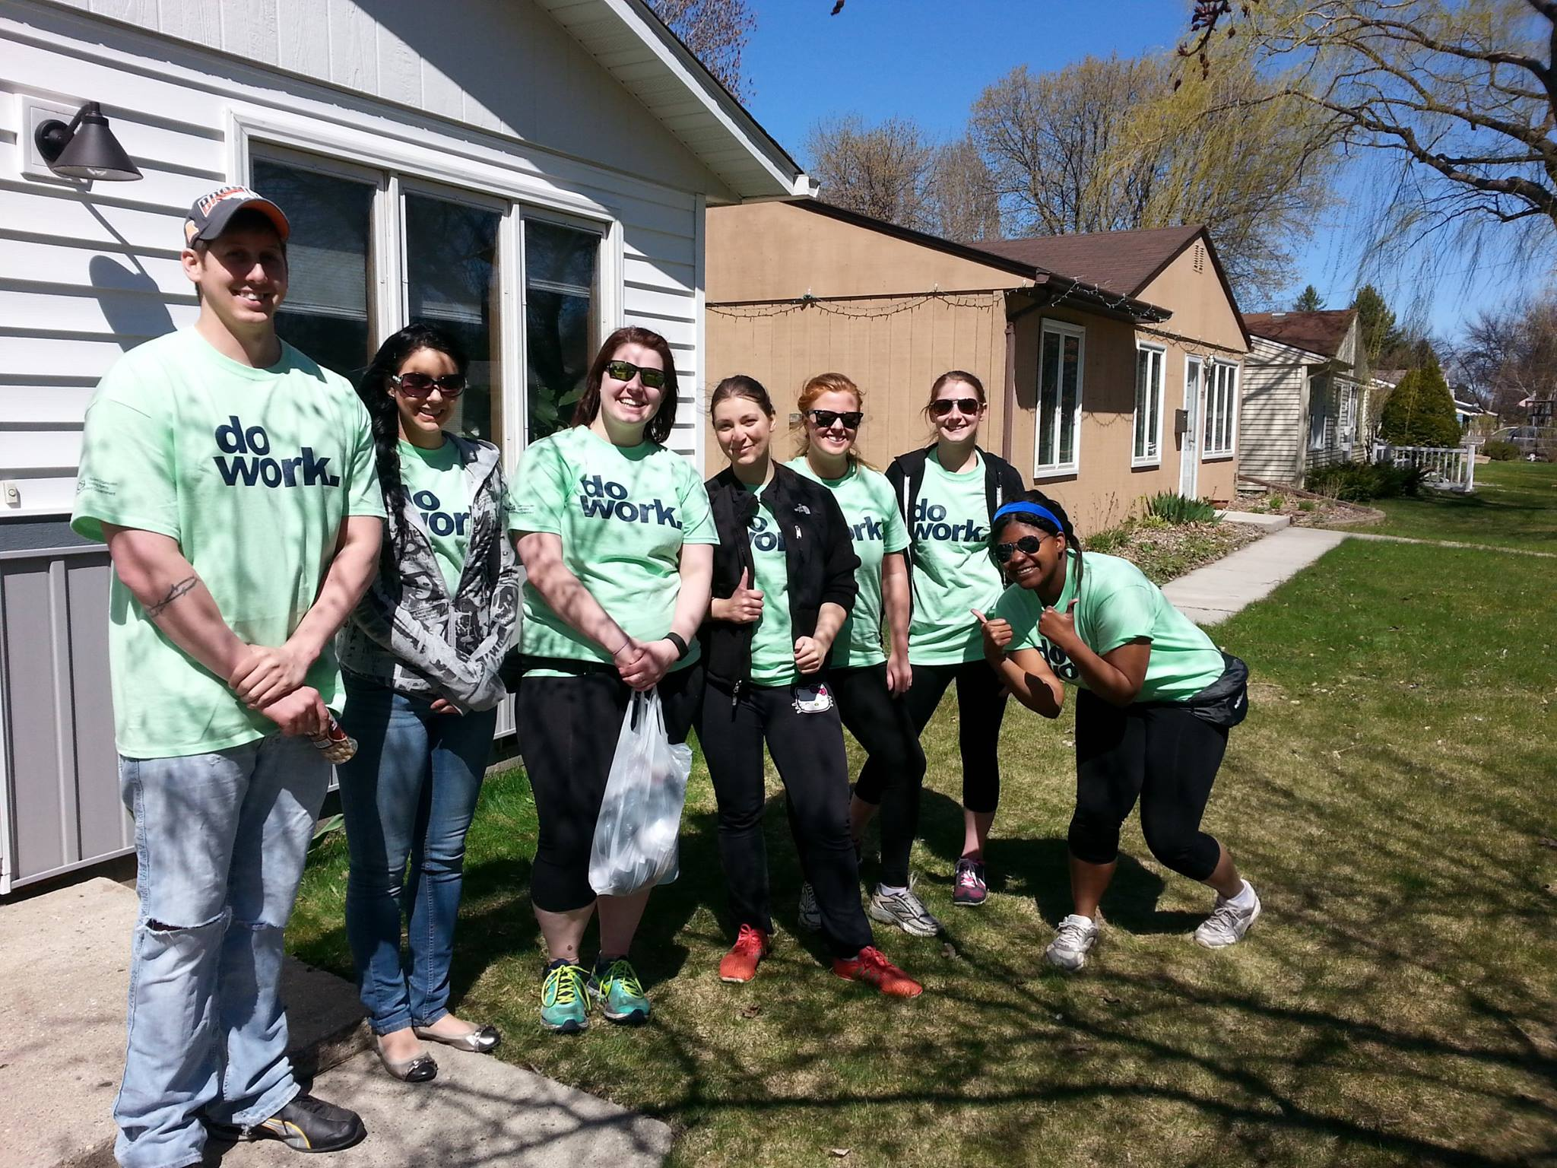

Slide 23
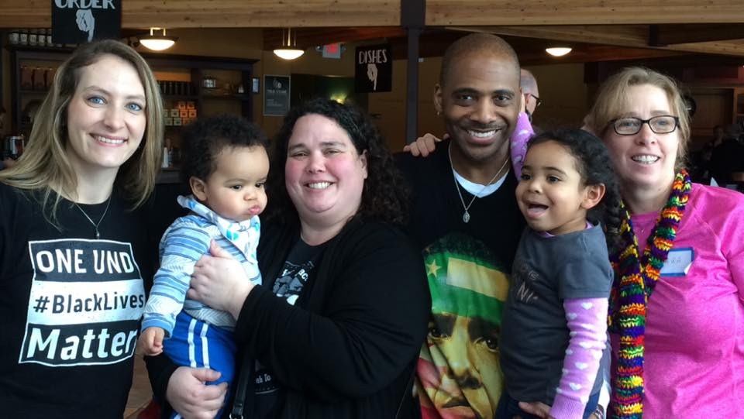
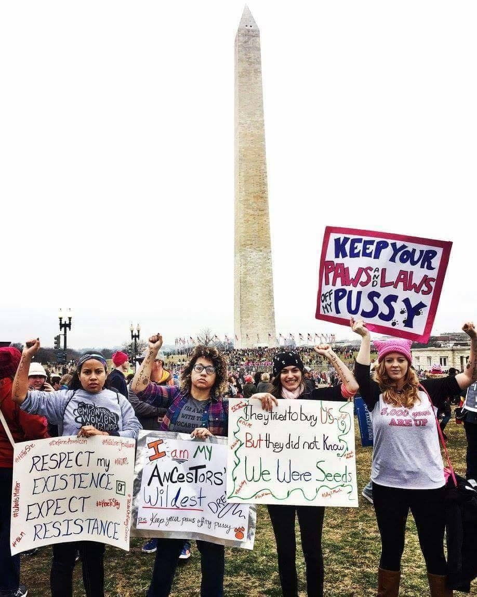
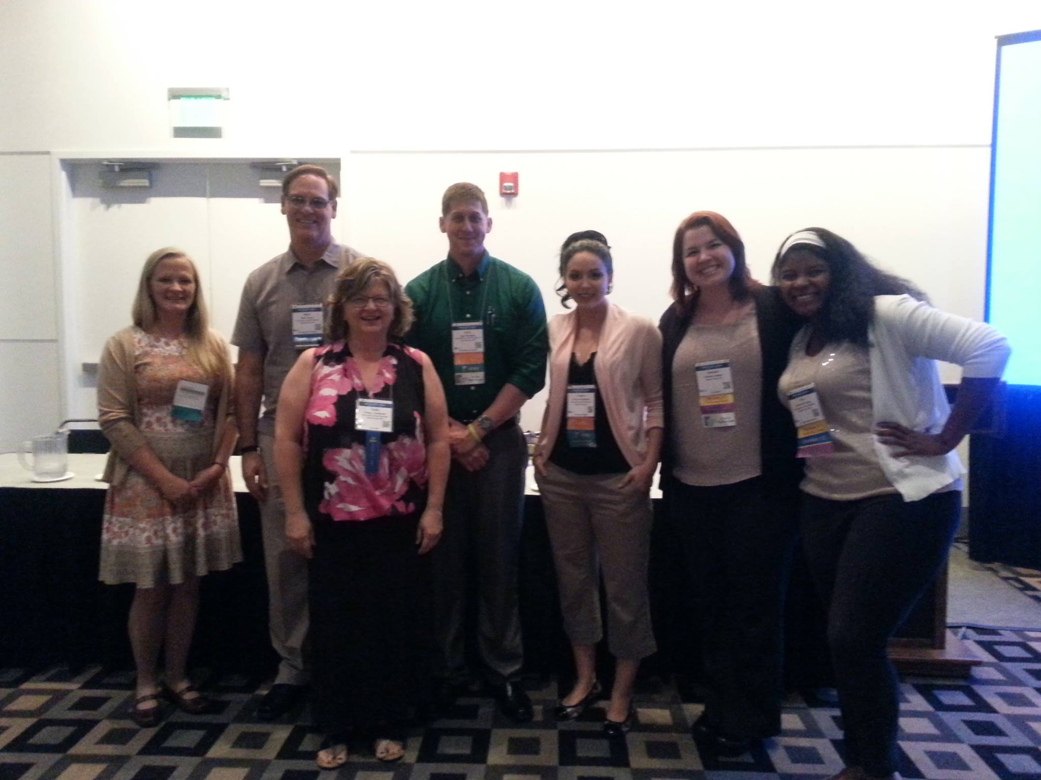

Slide 24
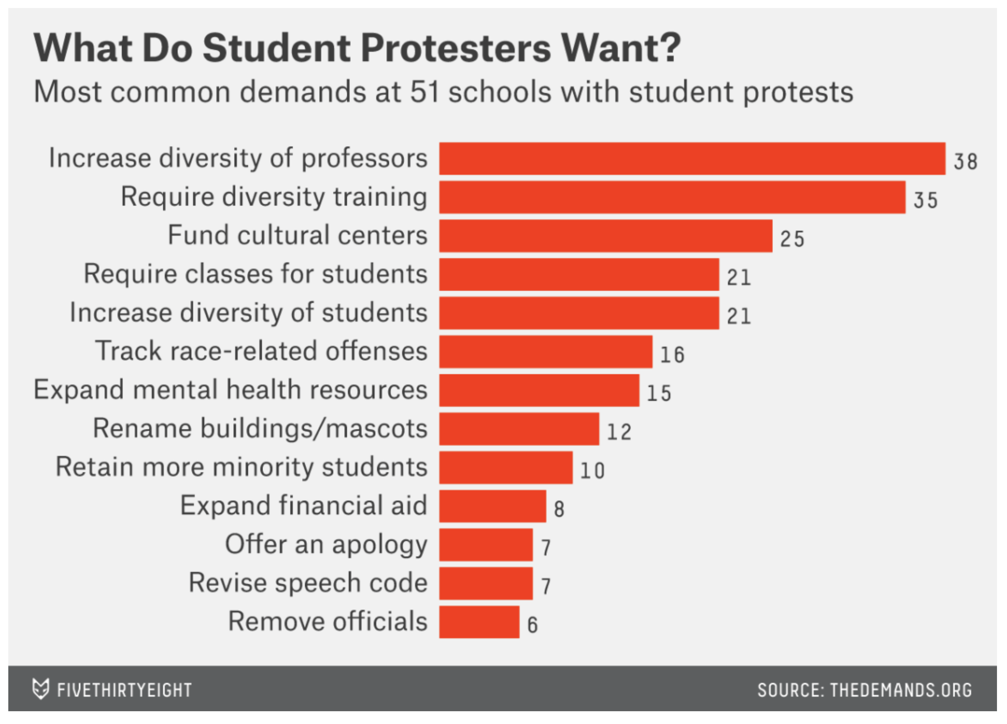

Slide 25
Main issues facing higher education
Faculty Recruitment and Retention
Recruitment and Retention of Students of Color
Curriculum that Reflects the Browning of America
Community Involvement
People of Color in Administrative Roles
Joe White, 2016

Slide 26

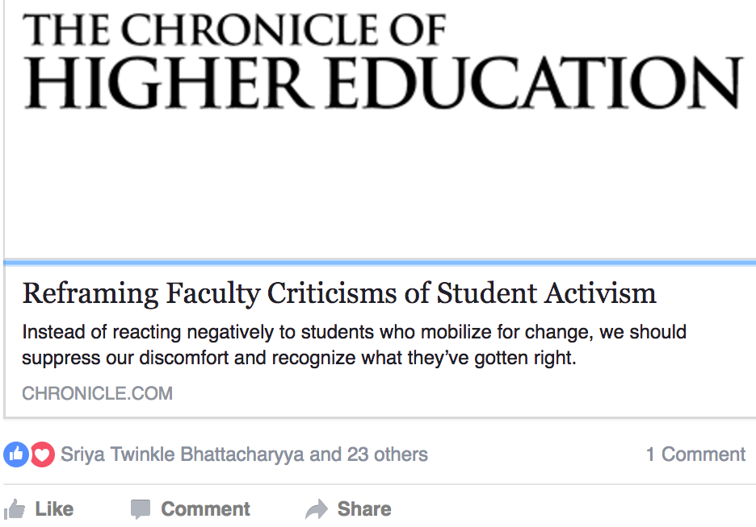

Slide 27
possible reframes
Appreciate their risk-taking. Taking up activism is a challenging task.
Consider power dynamics before framing faculty/administrators as victims.
People in positions of authority in institutions need to be able to receive feedback, to look for the truth in it rather than criticizing how it was delivered, and to respond with meaningful action.
If asking nicely worked….

Slide 28
Challenges and ethical considerations
Do the ends justify the means? Socially just ethics vs. ethical social justice
Use our expertise to address these issues on our campuses
Recognize different processes to achieve shared goals

Slide 29
Discussion
How can counseling psychology programs take an active role in shaping campus culture and policy to address issues of marginalization, discrimination, and oppression?

