Slide 1


Social Justice
Advocacy Training: Lessons from
Capitol Hill and Beyond
Amber A. Hewitt, Ph.D.

Slide 2
Overview
My Journey to Policy Work
Lessons from Capitol Hill
Executive Branch and Science Policy Work
What does Counseling Psychology have to offer?
Recommendations for advocacy and policy training
Benefits and Challenges to Advocacy and Policy Work
Resources

Slide 3
Disclaimer
This presentation was not created as part of my official duties as a Government employee. The views expressed in this presentation are my opinions and do not represent the views of the NIMH, NIH, or the United States Government.
No relevant disclosures

Slide 4
Overview
My Journey to Policy Work
Lessons from Capitol Hill
Executive Branch and Science Policy Work
What does Counseling Psychology have to offer?
Recommendations for advocacy and policy training
Benefits and Challenges to Advocacy and Policy Work
Resources

Slide 5

2013

Slide 6





Experiences that propelled me on my journey

Slide 7

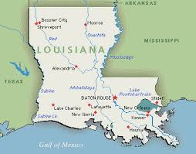



Slide 8
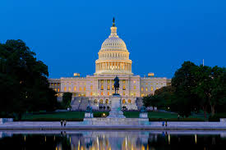

2016

Slide 9
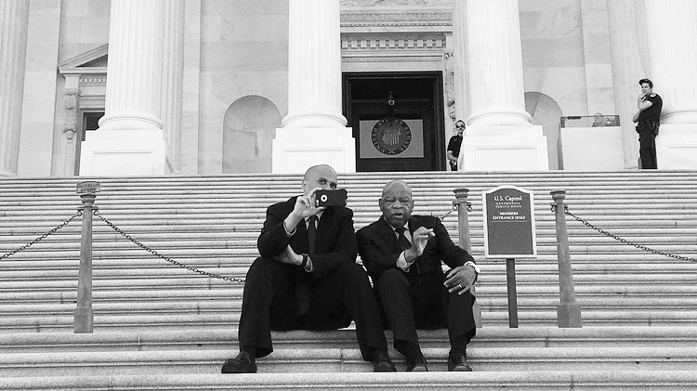

Slide 10
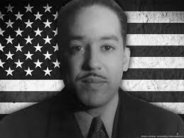
Our Mighty Dream

Slide 11
Overview
My Journey to Policy Work
Lessons from Capitol Hill
Executive Branch and Science Policy Work
What does Counseling Psychology have to offer?
Recommendations for advocacy and policy training
Benefits and Challenges to Advocacy and Policy Work
Resources

Slide 12

Role and Responsibilities
Meeting with advocacy groups
Writing memos and co-sponsorship requests
Coordinating with press on talking points and press releases
Engaging stakeholders on priority issues
Attending briefing and hearings
Researching legislative strategies
Co-drafting legislation

Slide 13


Health Policy Detours

Slide 14
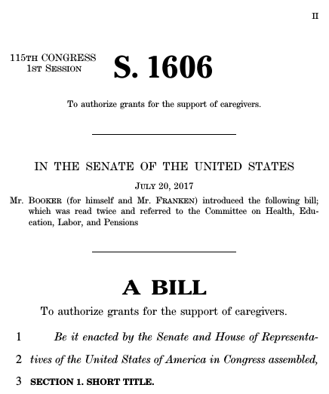


Slide 15

Legislation
Neglected Tropical Diseases
Sickle Cell Disease
Opioid Addiction
Maternal Health
  Domestic
  International

Slide 16

A Seat at the Table
  Understanding the Issues
    Health Care Reform
    Mental Health Parity
    Addiction
    Maternal and Infant Health
  Other Issues
    Caregiving
    Poverty
    Criminal Justice
    Environmental Justice
    Public Health
    Education policy

Slide 17
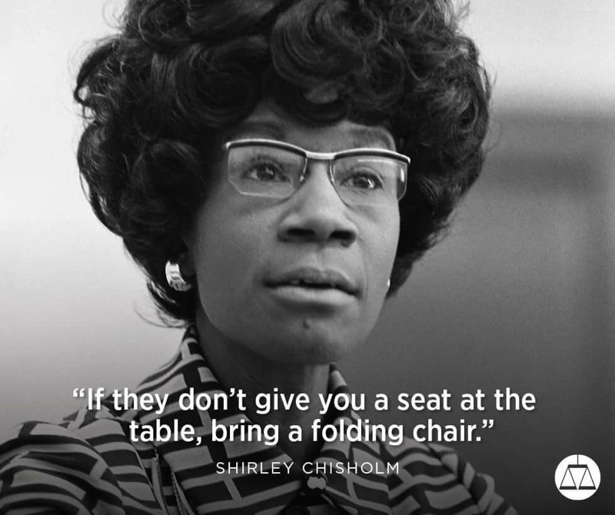

Slide 18

Notable Lessons
The decision-making context is almost always broader than the analysis framework.
Awareness of the political context of a policy area is essential to finding effective solutions, especially on Capitol Hill.
Policy-makers often relate to confirmation of intuitive logic and contextual narrative (Stories) much more than the results of detailed analysis, regardless of its quality or even clarity.

Slide 19
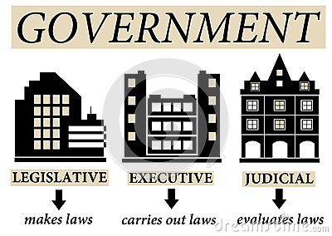
Legislative to Executive

Slide 20
Overview
My Journey to Policy Work
Lessons from Capitol Hill
Executive Branch and Science Policy Work
What does Counseling Psychology have to offer?
Recommendations for advocacy and policy training
Benefits and Challenges to Advocacy and Policy Work
Resources

Slide 21
NIMH Job Duties
Office of Science Policy, Planning, and Communications
  Drafting responses to Congressional, Departmental, or other stakeholder requests for information about the mental health research portfolio.
  Writing and editing documents that convey complex information about biomedical research to non-scientific audiences.
    Important skill to teach our students!

Slide 22
Focus for Advocacy
The Legislature
The Executive
Regulatory Agencies
The Judiciary
© Statewide Parent Advocacy Network

Slide 23
Types of Advocacy Writing
Op-Ed piece
Letter to editor
Press advisory/release
Letter to policymaker
Public testimony
Investigative report
Letters to inform & mobilize others
Activity notices

Slide 24
Overview
My Journey to Policy Work
Lessons from Capitol Hill
Executive Branch and Science Policy Work
What does Counseling Psychology have to offer?
Recommendations for advocacy and policy training
Benefits and Challenges to Advocacy and Policy Work
Resources

Slide 25
Lessons from the Executive Branch
Counseling psychology has much to offer:
  Typical development
  Context
  Diversity
  Intersectionality
  Social Justice
  Prevention

Slide 26
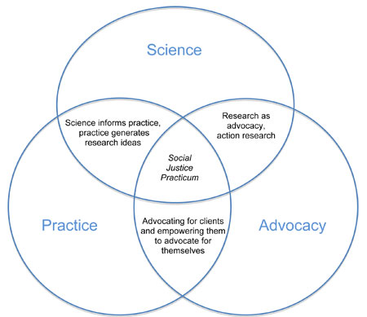
Counseling Psychology and the Hill
Social Justice
Clinical Skills
Advocacy Skills

Slide 27
(Lewis, Ratts, Paladino, & Toporek, 2011, p.9)
“Advocacy is not an ―add-on‖ that is separate from the counselor‘s work with clients and students. Advocacy is, instead, a natural outgrowth of the counselor‘s empathy and experience”
Advocacy is not an ―add-on‖ that is separate from the counselor‘s work with clients and
students. Advocacy is, instead, a natural outgrowth of the counselor‘s empathy and experience.

Slide 28
Overview
My Journey to Policy Work
Lessons from Capitol Hill
Executive Branch and Science Policy Work
What does Counseling Psychology have to offer?
Recommendations for Advocacy and Policy Training
  Pathways for Students
Benefits and Challenges to Advocacy and Policy Work
Resources

Slide 29
Training Recommendations
Special topics course on public (social) policy
Integrate policy throughout program curricula
Policy implications related to clinical and research interests
Make advocacy a part of comprehensive exams
Adapt assistantships to include advocacy
Develop an alumni network for advocacy mentoring and connections
Establish a student and/r faculty advocacy award
Incentivize students (and faculty) to attend advocacy days
Arrange program advocacy day

Slide 30


Congressional Fellowship
Sponsored by the American Psychological Association/ American Psychological Foundation
1-year on Capitol Hill
Partner with the American Association for the Advancement of Science (AAAS)
Distinctions
  William Bailey Fellowship
  Jacquelin Goldman Fellowship
  Catherine Acuff Fellowship

Slide 31
APA Executive Branch Fellowship
APA Executive Branch Science Fellows spend one year working as special assistants in executive branch science mission agencies, most often in research funding and coordinating office
  DOJ
  ACF
  HHS
  NIH
My cohort member worked at the National Institute of Justice (NIJ) where she provided subject-matter expertise and programmatic support for NIJ's research portfolios concerning children's exposure to violence and violence against women

Slide 32
Overview
My Journey to Policy Work
Lessons from Capitol Hill
Executive Branch and Science Policy Work
What does Counseling Psychology have to offer?
Recommendations for advocacy and policy training
Benefits and Challenges to Advocacy and Policy Work
Resources

Slide 33

Benefits and Challenges of Public Policy Work
Public policy and your professional identity
Understanding the policy making process
Engaging Stakeholders
It’s a multi-lane highway
Not just one moment
  Willingness to play the long game

Slide 34
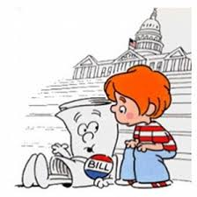

Slide 35
Overview
My Journey to Policy Work
Lessons from Capitol Hill
Executive Branch and Science Policy Work
What does Counseling Psychology have to offer?
Recommendations for Advocacy and Policy Training
  Pathways for Students
Benefits and Challenges to Advocacy and Policy Work
Resources and Tips

Slide 36
Resources
APA Advocacy Network and GRO
Dr. Jessica Henderson Daniel’s Citizen Psychology Initiative

Slide 37
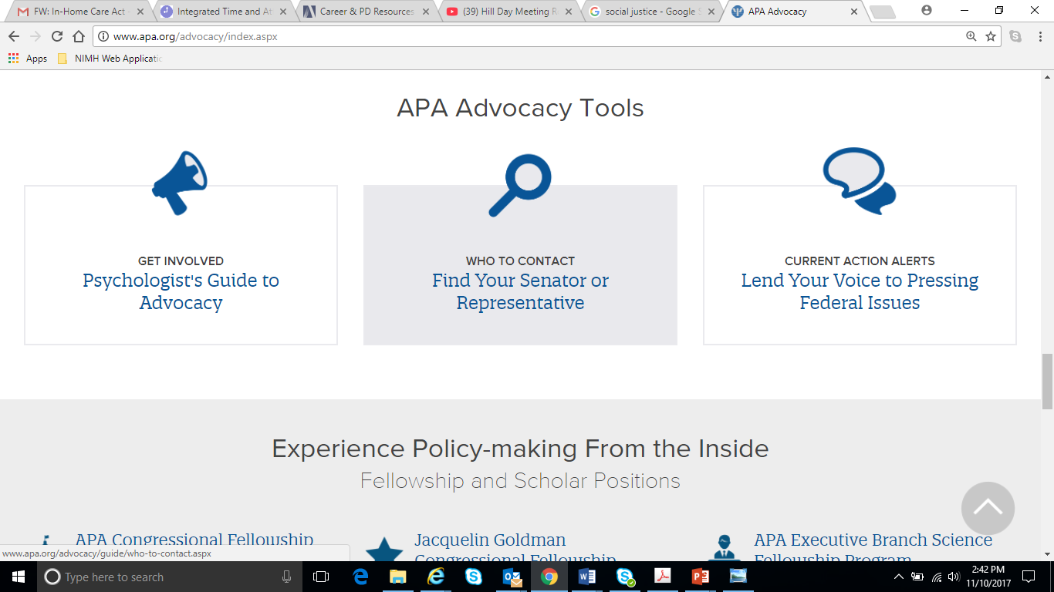

Slide 38
Additional Resources and Tips
Establish a relationship with your university’s federal affairs officers
Create a brief to accompany scholarly publications
Be open to provided expert testimony
Effective, Appropriate Communication
Create an advocacy team
  Chair
  Data Collector
  Relationship Builder
  Communicator
  Opportunist

Slide 39
Why Should you take action?
  Psychological knowledge can contribute to analyzing, understanding, and resolving key problems facing our nation.
  Federal and state policies affect our welfare as individuals, educators, researchers, practitioners, and students.
  If you don’t speak for our field and for whom it benefits, who will?
  APA Government Relations Office

Slide 40
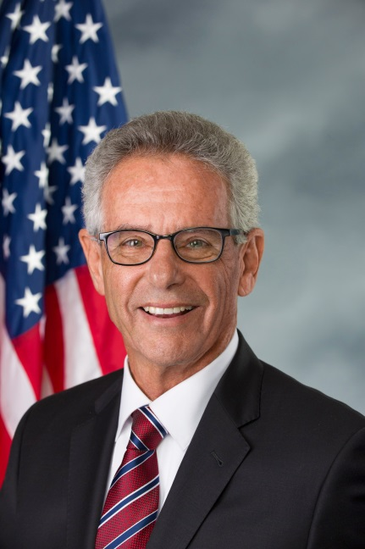
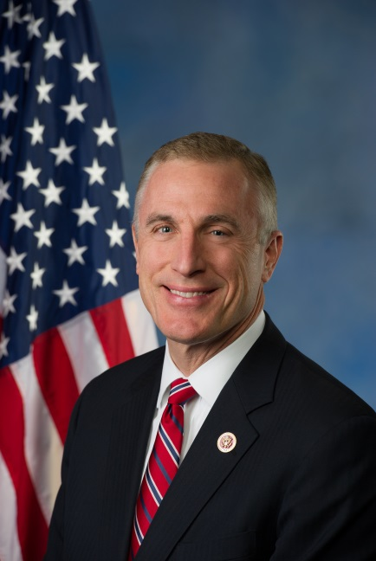
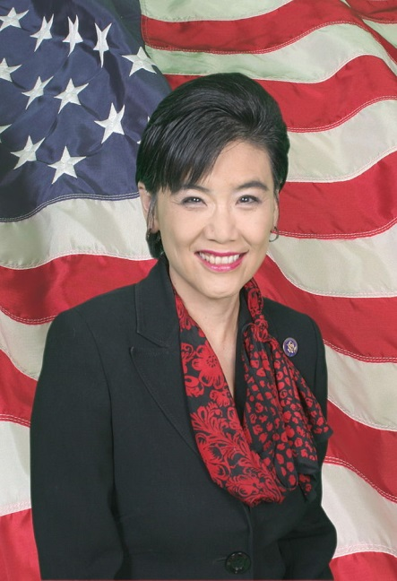
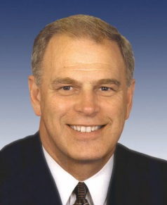
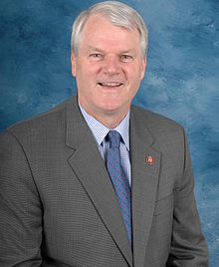
Psychologist Members of Congress
  Rep. Alan Lowenthal, PhD
  (D-CA)
  Community Psychologist
  Rep. Tim Murphy, PhD
  (R-PA)
  Current U.S. Navy Psychologist Child Psychologist
  Rep. Judy Chu, PhD
  (D-CA)
  Former Psychology Professor
  Former MFP Fellow
  Former Governor / Former U.S. Rep. Ted Strickland, PhD
  (D-OH)
  Counseling Psychologist
  Former U.S. Rep.
  Brian Baird, PhD
  (D-WA)
  Clinical Psychologist

Slide 41
Final Thoughts
Put our values into practice
Counseling Psychology has much to offer public policy
Address need to work with diverse stakeholders
Policy is all around us, so lets get more involved

Slide 42


