Slide 1
A Blueprint for APA Accreditation of Master’s Programs in Health Service Psychology James Lichtenberg, PhD, Task Force Chair Nadya Fouad, PhD, Task Force Member Cathi Grus, Acting Chief Education Officer

Slide 2
Agenda
Introductions
Background
Review of Task Force Charge
Task Force Recommendations
Additional Recommendations and Considerations
Next Steps
Questions

Slide 3
Background
In March 2018, Council approved a motion to pursue “accreditation of master’s level programs in psychology in areas where APA already accredits.”
After the action was approved at the March 2018 Council meeting, the Board of Educational Affairs developed and disseminated a call for nominations, for a Task Force that would be charged with developing a blueprint for APA to pursue accreditation of master’s programs in health service psychology.

Slide 4
Background
The decision to pursue accreditation of master’s programs in health service psychology (HSP; clinical, counseling, school), stemmed from a discussion at the August 2017 Council meeting.
At the end of the discussion Council approved the following statement:
“Current issues and developments have risen to the level that APA should consider options related to master’s level training and/or practice and that staff and governance should identify and explore options for APA to consider.”

Slide 5
Background
Board of Educational Affairs (BEA) developed a Call for Nominations
Call disseminated in April 2018
Approximately 66 nominations received
In June BEA appointed an 8-person Task Force
Members have broad range of expertise and represent diversity across many dimensions
Dr. Jim Lichtenberg, Chair & Dr. Celeste Malone, BEA Liaison

Slide 6
Background
Monthly calls between July and October
Met in-person on November 30-December 2, 2018
Consulted with key stakeholders
Masters in Counseling and Psychology Accreditation Council (MPCAC)
National Association of School Psychologists (NASP)
APA Office of Program Consultation and Accreditation (OPCA)
Association of State and Provincial Psychology Boards (ASPPB)

Slide 7
Task Force Charge
Outlining a plan by which APA could pursue development of an accreditation system for master’s HSP programs
Specifically:
Developing a statement that broadly delineates the scope of accreditation
Prioritizing possible pathways for APA to establish accreditation
Identifying the necessary expertise to conduct accreditation reviews

Slide 8
Scope of Accreditation

Slide 9
Scope of Accreditation
Reviewed documents:
APA Standards of Accreditation (current accreditation standards for HSP)
Blueprint for Education and Training in Professional Psychology in Health Care Services (Health Service Psychology Education Cooperative, 2013)
Resolution on Quality Assurance in International Education and Training (https://www.apa.org/about/policy/quality-assurance-resolution.pdf)
First Street Accord (https://www.apa.org/ed/accreditation/signed-accord-cpa.pdf)
Jackson & Scheel (2013): Quality of master’s education: A concern for counseling psychology? The Counseling Psychologist, 41(5), 669-699.

Slide 10
Scope of Accreditation
Considered different routes to master’s degrees
Stand-alone programs
Integrated within HSP doctoral programs

Slide 11
Recommendations
The scope of accreditation only apply to HSP master’s programs within the United States and its territories.
Accredited master’s programs in HSP must meet a set of standards leading to a specific set of professional competencies and outcomes. These may be accompanied by additional programs specific to education and training.
The knowledge and competencies that are common to clinical, counseling, and school psychology represent the core of HSP.

Slide 12
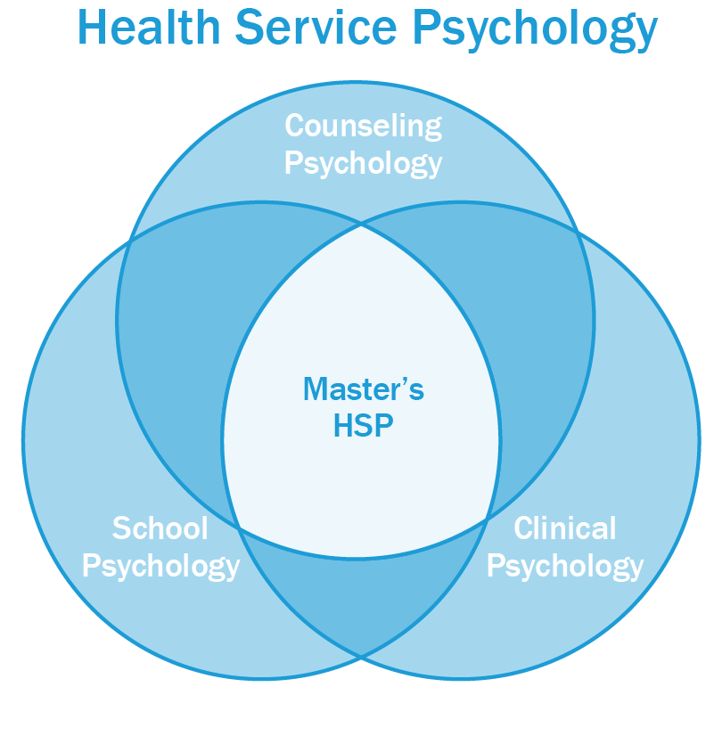
Recommendations
Master’s level accreditation in Master’s level accreditation in HSP indicates that the program matriculates students who meet the required standards for the core of HSP.
Accreditation of programs in HSP at the master’s level is part of the continuum of education and training in HSP.

Slide 13
Possible Pathways

Slide 14
Possible Pathways
Prioritizing possible pathways for APA to establish accreditation of master’s programs in psychology.
Two Options: Expand current APA CoA or create new accrediting commission.

Slide 15
Possible Pathways
Option 1: Expand APA CoA
Advantages
Already recognized by US Department of Education. (US ED) and Council of Higher Education Accreditation (CHEA), faster and more efficient to expand scope.
Consistent with continuum of HSP SoA
Capitalize on expertise of staff and current Commissioners
Disadvantages
Will require an expanded focus to include the development of accreditation standards and areas of expertise for those who are serving as evaluators
Resources needed for CoA commissioners and staff, space, technology

Slide 16
Possible Pathways
Option 2: New System
Advantages
Might be easier to develop
Understanding the resources needed may be more meaningful or accurate with a separate accrediting system
Disadvantages
Time to attain recognition from DOE and CHEA
Resources may be redundant with the current APA CoA

Slide 17
Relationship with Other Entities
Many other accrediting or approval bodies recognize mental health practitioners at the master’s level.
Only two are grounded in the HSP competencies and overlap: Masters in Psychology and Counseling Accreditation Council (MPCAC) and the National Association of School Psychologists (NASP).
Recommend APA work collaboratively with MPCAC and NASP, acknowledging the important role that these organizations have played in accrediting master’s level training.

Slide 18
Recommendations
Option #1 – Expand Current APA CoA
More efficient
Critically urgent to be expedient in recognition of accrediting body
Part of continuum of training in HSP
Consistent with the SoA
Identify mechanism to recognize programs already accredited by MPCAC or NASP
Explore efficiencies in re-accreditation processes for universities with multiple HSP programs

Slide 19
Identifying the Necessary Expertise

Slide 20
Necessary Expertise
Reasons for Expanding the APA CoA
Ensure representation of master’s level HSP expertise on APA CoA.
Allow APA CoA to accommodate increased workload to enable the field of psychology to better meet the public’s needs for mental health services.
Foster alignment and coordination across all HSP accreditation levels
Facilitate full integration of master’s level HSP stakeholders on APA CoA

Slide 21
Recommendations*
Two faculty members from terminal HSP master’s program
One faculty member from a master’s program integrated within a doctoral HSP program
Three seats nominated from appropriate master’s training councils
Two master’s level HSP practitioners
One student from a terminal master’s HSP program
A sufficient number of public members *This represents a proposal for an initial expansion. Further expansion may be needed.

Slide 22
Additional Recommendations & Considerations

Slide 23
Additional Recommendations & Considerations
Bring clarification and differentiation of the competencies expected of those completing an accredited master’s program in HSP, in contrast to the competencies of those completing an accredited doctoral program.
Understand and value master’s programs in HSP as a part of the sequential, cumulative, increasingly complex nature of graduate training and professional practice in HSP.
Master’s training in HSP should not be viewed as HSP training “lite,” but rather as the significant—indeed foundational--portion of training in HSP that it is.

Slide 24
Additional Recommendations & Considerations
APA CoA’s workload will increase and in addition to the expansion of APA CoA members the OPCA will be impacted and additional association resources.
APA CoA will play a significant role as these efforts move forward.
Consider exploration and development alternative pathways to accreditation for those programs that are already
Programs are not to be “grandfathered in” as APA accredited programs, but provided with a way to move expeditiously toward accreditation given their current accredited/approved status.

Slide 25
Next Steps
Council will be asked to receive the report
Council discussion at February meeting to offer input on competencies needed
Task Force to articulate competencies
APA CoA develop standards (with opportunities for stakeholders to provide comment)
Council will be asked to approve the standards

Slide 26
QUESTIONS

