Slide 1
APPIC REPORT TO CCPTP
Mary Mendoza Newman Ph.D.
APPIC Board Liaison to CCPTP
February 2019

Slide 2
ORGANIZATIONAL & MEMBERSHIP UPDATE

Slide 3
APPIC CENTRAL OFFICE STAFF
Executive Director - Jeff Baker, Ph.D., ABPP
Membership Services, IT and Database - Jessica Shapley
Dues, Newsletter and Financial Services - Te’yonna Kossie
Match Coordinator - Greg Keilin, Ph.D.

Slide 4
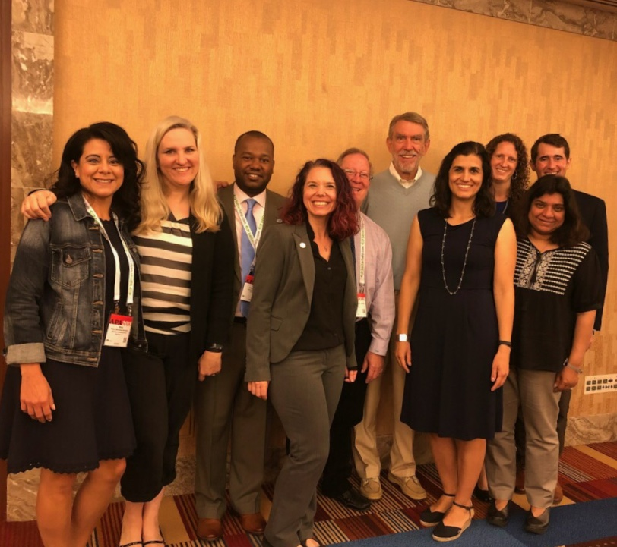
CURRENT APPIC BOARD
Mariella Self, Ph.D., ABPP - Chair
Claytie Davis, III, Ph.D., ABPP - Vice Chair
Mary Mendoza-Newman, Ph.D. - Secretary
Allison Aosved, Ph.D., ABPP - Treasurer
Kimberly Hill, Ph.D. - Board Member
Daniel Hurley, Ph.D. - Board Member
Shona Vas, Ph.D. - Board Member
H. Garland Hershey, DDS - Public Member
Allison Ponce, Ph.D. - Past Chair
Notes:
APPIC also has 8 standing committees and is appreciative of it’s committee chairs and members, as well as our listserve manager and newsletter editor We are also pleased to have welcomed Debi Bell as the Editor of TEPP.

Slide 5
APPIC MEMBER PROGRAMS
788 APPIC-Member Internship Programs (40 Canadian)
621 APA accredited
35 CPA accredited
210 APPIC-Member Postdoctoral Programs (0 Canadian)
89 APA accredited

Slide 6
MATCH DATA & TRENDS

Slide 7
GENERAL PARTICIPATION (December 31, 2018)
3,753 registered applicants (67 + compared to 2017)
3,902 positions offered (23 -)
Accredited: 3,436 (63 +)
Unaccredited: 466 (86 -)
788 Internship Sites
APPIC Members: 747 (2 +)
Non-APPIC Members: 41 (8 -)

Slide 8
WHAT DOES THIS MEAN?
More positions than applicants
Accredited positions continues to grow, with 88% of positions being accredited
There continues to be an imbalance between number of applicants and ACCREDITED positions
Growing number of programs with less than two interns
Impacts both APPIC membership and APA Accreditation
Making it harder for unaccredited programs to recruit
Difficult landscape to start a new training program

Slide 9
COUNSELING PSYCHOLOGY SPECIFIC DATA (2018 Match Data)
APPLICANT RESULTS BY DOCTORAL PROGRAM TYPE AND DEGREE COMBINED PHASE I/II (2018 Data)
PROGRAM TYPE | DEGREE SOUGHT | MATCHED |  | UNMATCHED |  | WITHDREW OR NO RANKINGS SUBMITTED |  | TOTAL
Clinical | Ph.D. | 1,345 | 94.3% | 44 | 3.1% | 38 | 2.7% | 1,427
 | Psy.D. | 1,420 | 93.0% | 65 | 4.3% | 42 | 2.8% | 1,527
 | TOTALS | 2,765 | 93.6% | 109 | 3.7% | 80 | 2.7% | 2,954
Counseling | Ph.D. | 382 | 95.5% | 7 | 1.8% | 11 | 2.8% | 400
 | Psy.D. | 66 | 81.5% | 8 | 9.9% | 7 | 8.6% | 81
 | TOTALS | 448 | 93.1% | 15 | 3.1% | 18 | 3.7% | 481
School | Ph.D. | 172 | 87.3% | 10 | 5.1% | 15 | 7.6% | 197
 | Psy.D. | 23 | 71.9% | 6 | 18.8% | 3 | 9.4% | 32
 | TOTALS | 195 | 85.2% | 16 | 7.0% | 18 | 7.9% | 229
Combined | Ph.D. | 58 | 92.1% | 3 | 4.8% | 2 | 3.2% | 63
 | Psy.D. | 52 | 100.0% | 0 | 0.0% | 0 | 0.0% | 52
 | TOTALS | 110 | 95.7% | 3 | 2.6% | 2 | 1.7% | 115
Notes:
47% of Counseling Psych Applicants go to UCC

Slide 10
CURRENT APPIC INITIATIVES

Slide 11
CURRENT APPIC INITIATIVES
AAPI Online Revision
Planning for a new platform allowing for updates and easier navigation
Getting input from stakeholders about updates and changes to implement in short-term and longer-term
Informal Problem Consultation
Ongoing resource for Doctoral Program Directors, TDs, and trainees when challenging situations arise
Common Themes – competency concerns and due process, pregnancy, medical illness, visas, and additional requirements post-Match (Background checks, contracts from doctoral programs)

Slide 12
CURRENT APPIC INITIATIVES
Accreditation Readiness Project (ARP)
Supporting APPIC internship programs moving towards APA Accreditation
4th year of this program
12 programs supported this year with monthly objectives, consultation, and creation of learning communities
Goal of submitting self-study by December 2019
Postdoctoral - Membership Readiness Project (P-MRP)
Supporting postdoctoral programs moving towards APPIC Membership
New program developed this year, commenced in October 2018
17 programs participating this year with monthly objectives, consultation, and creation of learning communities
Goal of submitting APPIC Membership Application by April 2019

Slide 13
INVESTMENT OF RESOURCES FOR APPIC MEMBERS, DPAS, & STUDENTS/TRAINEES
Annual investment of 50K for TEPP journal
Underwrite biennial membership conference (~70K for 2018)
Enhancements to eMembership, Directory On Line (DoL), AAPI Online, and APPA CAS
Development and enhancement of the Universal Psychology Postdoc Directory (UPPD) and other postdoc initiatives
Special projects (e.g., 50K to Accreditation Readiness Project and Postdoctoral-Membership Readiness Project)
Address current issues and support for the training community (e.g., parental leave guidelines, FLSA, Informal Problem Consultation)

Slide 14
2020 Membership Conference
Coming Spring 2020

Slide 15
STAKEHOLDER FEEDBACK

Slide 16
REQUEST FOR STAKEHOLDER FEEDBACK LAUNCHED
Consideration of creating a new APPIC Provisional Member category
Meant to maintain high quality standards for training programs AND to allow a feasible pathway to develop as a training program and become APPIC members
Proposal to meet all membership criteria other than needing 2 interns on site
Time limited for up to 3 years
Consideration to require accreditation for internships to be APPIC members
Goal of maintaining high quality standards
Hope to support members, as harder to recruit without accreditation
Programs would have lead time prior to implementation
APPIC exploring how to support member programs to move towards accreditation

Slide 17
CONTACTS
Mary Mendoza Newman, Ph.D.
APPIC Board Liaison to CCPTP
Stanford University
marymn@Stanford.edu

