Slide 1
Council of Counseling Psychology Training Programs Midwinter Conference
New Challenges. New Horizons:
Counseling Psychology in Unsettling Times
THRIVING THROUGH PASSION AND PERSERVERANCE: LESSONS FROM "MARGINALIZED" COMMUNITIES
Dr. Patricia Arredondo
President, Arredondo Advisory Group

Slide 2
Land Acknowledgement
We acknowledge the First Peoples of our countries, as the custodians and occupants of the traditional lands where we live, work, and recreate. We pay our respects to the Elders past, present, the seven generations yet to come, and to their continued connection to the land and community.
- APA’s Division 45 Warrior’s Path Presidential Task Force (2020). Protecting and Defending our People: Nakni tushka anowa (The Warrior’s Path).
@aahheorg #AAHHE21

Slide 3
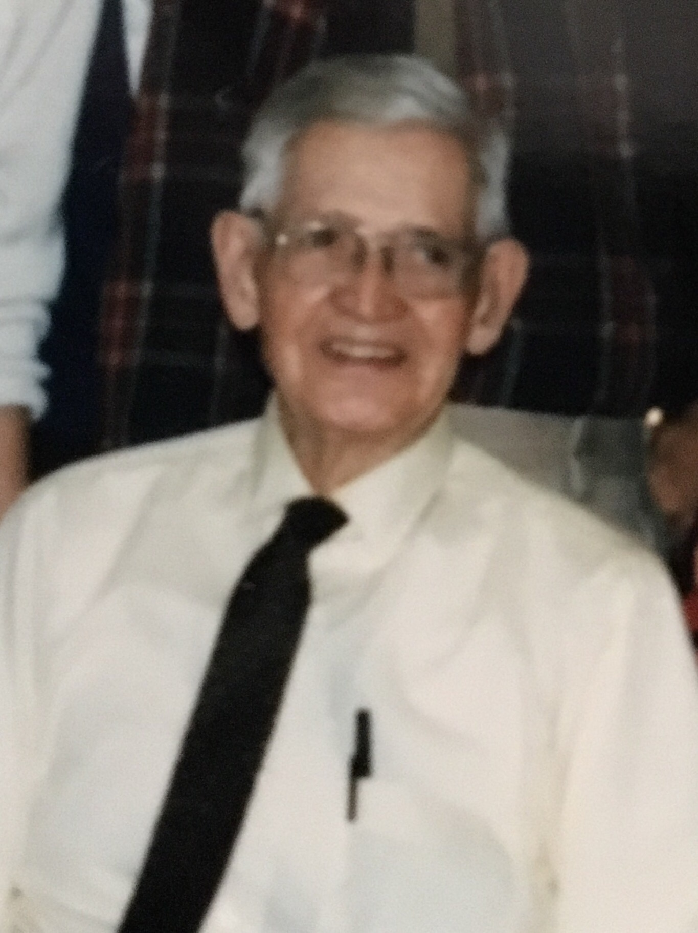
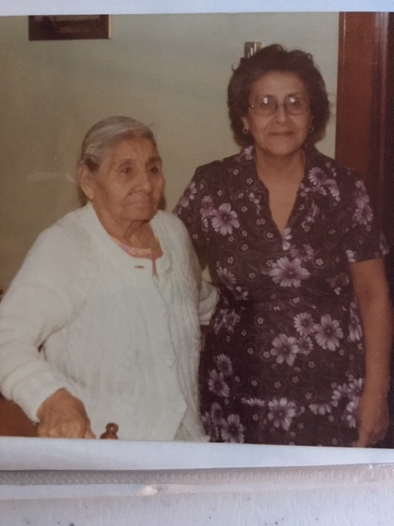
Dedicated to Dad, Mom y Mamá—enseñanzas y ejemplares for feminism & inclusion
Apolinar Arredondo
Marí Estefana Zalidvar & Eva
Notes:
Setting the personal and professional context. Walking the borderlands, learning to thrive, not simply survive. Recognizing that motivation alone is not enough. Courage is modeled and shared by people in our lives.

Slide 4
Notes:
Land Acknowledgement.
Cultural competency development begins with us. Essential to know the worldviews that inform out outlook on life, our priorities, how we plan for change, position ourselves from a strengths versus deficit perspective. Every context is culture-bound and the values and norms in those context may or may not affirm our Latinidad, our mujerista worldview, or our social justice advocacy for confronting inequities. Leading forward in a racist, sexist, homophobic, and classist society is not a choice.. Color is difference and deficit to always confront.

Slide 5
Inquiries to Lead Transformation
Does social responsiveness mean--being an anti-racist, an agent of transformation, a risk-taker?
What do you envision for culture-centered, anti-racist & EDIA education & training today and for the next 20 years? What actions will lead to culture change in CP programs and beyond?
How will you embed the psychology of liberation and socially responsive program policies, evaluation, curriculum and outreach?
What is the mindset and roadmap to prepare and create agency collectively? Plans for action.
How do you empower those who will replace you?
Notes:
It is about transformation, not simply change. Requires an integrative, collectivistic approach.

Slide 6
Courage & ganas
Leaders and Practitioners of Liberation and Social Transformation

Slide 7
Tarana J Burke - Founder of #MeToo Movement
The movement was born in 2006 from Tarana’s passion as a community organizer around social justice advocacy that evolved upon hearing stories of adversity in increasing numbers of Black women(Get to Know Us, 2020).
Time Person of the Year-2017

Slide 8
Dellara Gorjian - DACA leadership—We are the Dreamers
Recognized for her role in the passing of the University of California’s Supreme Court challenge to the attempt to dismantle DACA.
Gorjian migrated to the US from Canada at age 5 and was one among many DACA recipients who were facing deportation during the term of the previous administration.

Slide 9
Alicia Garza - Black Lives Matter
Alicia Garza is one of the founders of the Black Lives Matter Movement.
Garza stressed the building of movements is in building alliance, rather than following.
The Purpose of Power: How we Come Together when We Fall Apart (2020).

Slide 10
Laverne Cox - Transgender Representation
Laverne Cox, known for her role in Orange is The New Black.
An openly transgender actress and leader in representation for this marginalized group.
Executive producer of Netflix documentary on the history of transgender representation in the US.

Slide 11
Dolores Huerta – Feminist & Social Justice Activist
Receiver of Presidential Medal of Freedom in 2012, Dolores Huerta is recognized for her work in Community Service Organization and a lifetime of activism for low-wage workers.
Dolores’ work with César Chávez, evolved into contending with other men in lobbying for social justice initiatives that secured economic power.
Age 91

Slide 12
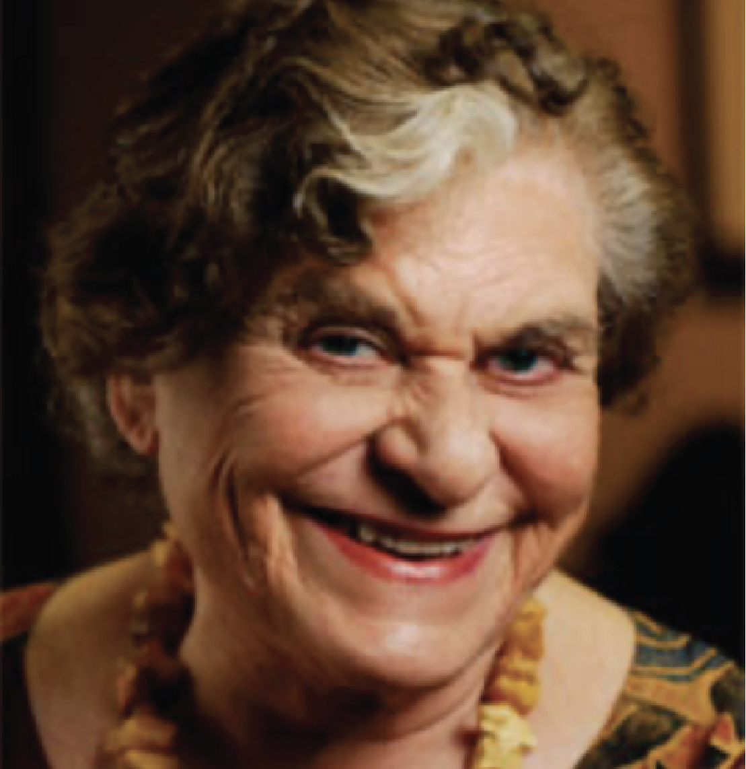
Gay Sons & Mothers— Mothers who Inspire
Suzanne Loebel—The Mother’s Group of Love, Loss & AIDS
Holocaust Survivor
Age 96

Slide 13
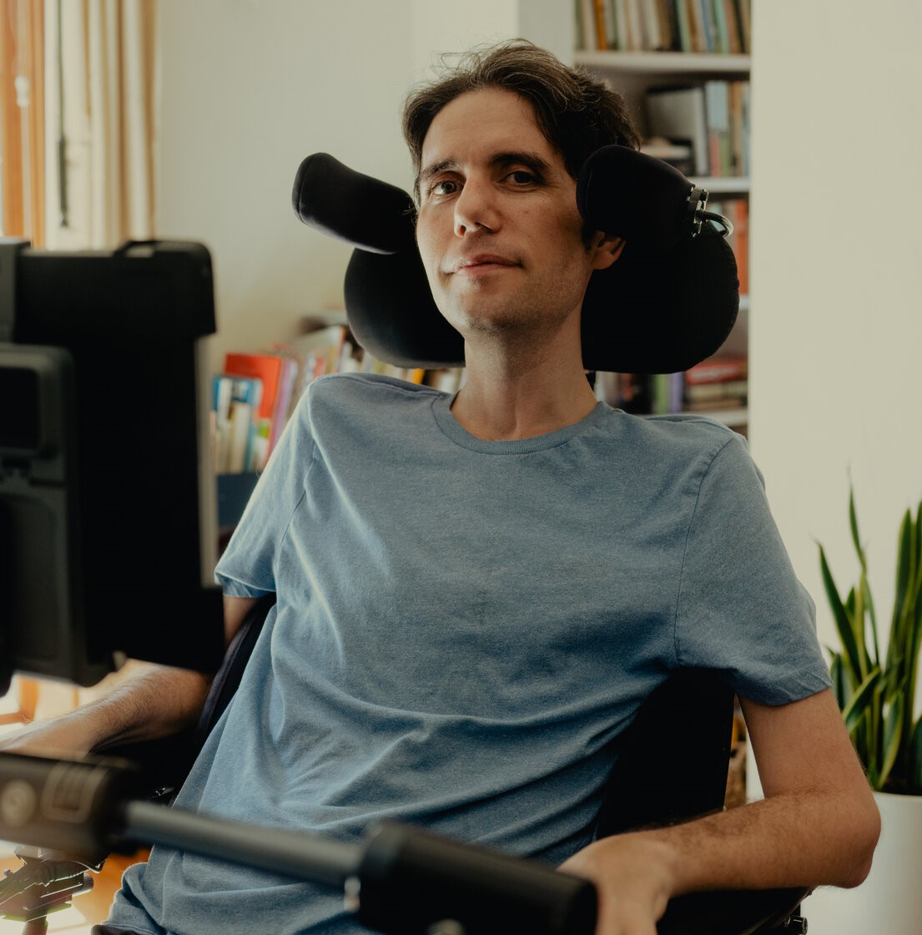
Ady Barkan Center for Popular Democracy
Co-founder of BE A HERO PAC.
Attorney & activist

Slide 14
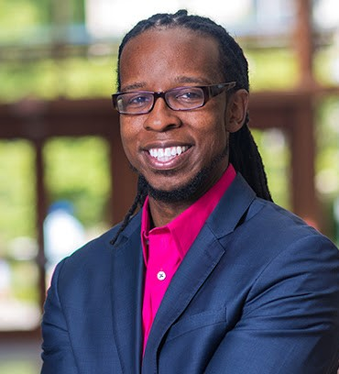
Ibrahm X. Kendi Director, Center for Anti-Racist Research
"We need to make the systems and policy changes that marginalize particular segments of society.
It is not the people so much as the systems that need to change."

Slide 15
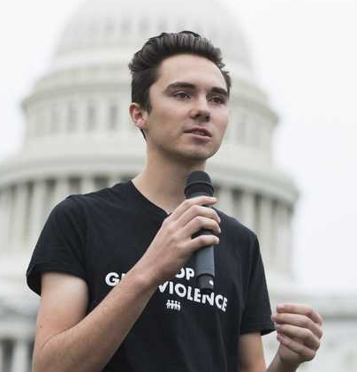
David Hogg Gun Control Activist
Parkland Shooting survivor
“March for our Lives” leader
Gun control activist
A challenger to the My Pillow CEO

Slide 16
Common Denominators of Transformers
Passion and Intentionality
Systematic plans to upend embedded structural barriers to EDIA and racism
Clarity about desirable outcomes
Collective agency for thriving—bringing others along
Continuous journeys to transform—always in a process of becoming
© Empowerment Workshops, Inc.

Slide 17
ROADMAP for ORGANIZATIONAL TRANSFORMATION (Arredondo, 1996)
THE LEGACY
INITIAL AND SECONDARY TACTICS
WHO GETS A SEAT ON THE BUS?
ACTIONS TO BUILD UPON
COST-BENEFIT ANALYSIS: RISKS TO CHANGE
WHAT ARE THE SYSTEMS AND POLICIES THAT NEED TO GO AWAY?
CLARIFYING THE MOTIVATORS AND WHY NOW?
© Empowerment Workshops, Inc.

Slide 18
DEI-Centered Scorecards

Slide 19
Best Practices for Search Committees | In Place: 0-Don’t know 1-No 2-In Progress 3-Yes | IMPORTANCE: 1-not important 2-important 3-very important
Receive a charge from a senior leader to carry out the search.
Intentionally reflect inclusive diversity.
Receive training on diversity, equity and inclusion for all search committee chairs and members.
Acknowledge to one another “What diversity means to me”.
Are familiar with “best practices” for conducting searches.
Review common biases in search practices, e.g., implicit bias “Presumed Incompetence, ideological differences, assumptions about fit”.
Follow consistent processes and practices for all searches across the campus.
Sign a confidentiality contract to ensure privacy of discussions.
Outline practices to manage boundaries with internal candidates.

Slide 20
Best Practices for Search Committees (Continued) | In Place: 0-Don’t know 1-No 2-In Progress 3-Yes | IMPORTANCE: 1-not important 2-important 3-very important
Prepare ads that incorporate language about the College’s prioritization for DEI and request a diversity statement from candidates.
The Search Committee chair is committed to DEI and can provide leadership if questioned about the importance or value of DEI efforts.
Have clear guidelines for initial screenings of candidates to prevent bias
Contain either an HR representative, representative from the Provost’s office, or neutral 3rd party in the initial screenings, e.g. diverse faculty or staff member from another College discipline or department.

Slide 21
Best Practices for Screening and Interviewing Applications | IN PLACE: 0-Don’t know 1-No 2-In Progress 3-Yes | IMPORTANCE: 1-not important 2-important 3-very important
All search committee members participate in outlining screening process
Job descriptions and candidate selection criteria are up to date
Objective candidate evaluation forms with rating scales are available
Candidates’ diversity statements are one criteria for selection
INTERVIEWING CONSIDERATIONS
Interviewers are trained and/or coached on what questions are appropriate or inappropriate to ask in an interview (also, which are legal/illegal)
The agenda/itinerary includes time spent with key department, college and university representatives
Each candidate has equal access to senior leadership and key department representatives and decision makers
Candidates are welcomed and receive a campus tour and/or an opportunity to see non-academic campus spaces, e.g. sports, religious facilities and student centers

Slide 22
Best Practices for Screening and Interviewing Applications (Continued) | IN PLACE: 0-Don’t know 1-No 2-In Progress 3-Yes | IMPORTANCE: 1-not important 2-important 3-very important
Candidates learn about local resources campuses
Time is managed equally, properly and consistently
The same interview questions are used for each candidate for the same position opening, especially for initial screening
Interviews are held in spaces that reflect diversity
Interviews allow sufficient time for the candidate to answer questions and ask questions
“Window dressing” with underrepresented individuals does not occur for interviews
In certain institutions, a candidate’s current salary is not made available to avoid perpetuation of discrimination
Candidate evaluation forms are completed and collected from all constituents, staff, students, and faculty through anonymous electronic means, i.e., Qualtrics
Interviewers are trained and/or coached in cultural competence and inclusive excellence.

Slide 23
Best Practices for Outreach and Recruitment Plans | WE HAVE: 0-Don’t know 1-No 2-In Progress 3-Yes | IMPORTANCE: 1-not important 2-important 3-very important
Search Committee develops a strategy with actionable practices that can be carried out by committee members. Some are below.
Outreach plans include professional associations of different social identities, e.g. Association of Black Psychologists, American Association of Hispanics in Higher Education, etc., Asian American Psychological Association, Society of Indian Psychologists, HBCU Association
Outreach is made to professional associations of a specific discipline, i.e. computer science, nursing, engineering
The department has a “go to” list of ethnic-specific professional associations based on disciplinary areas
Outreach is conducted at regional and national conferences
Personal calls are made to targeted individuals and through one’s networks
Well-established, underrepresented individuals in a given discipline are invited to present their research and other relevant work samples

Slide 24
Best Practices for Outreach and Recruitment Plans (Continued) | WE HAVE: 0-Don’t know 1-No 2-In Progress 3-Yes | IMPORTANCE: 1-not important 2-important 3-very important
Outreach is made to well-established professionals who would be value-added to the College’s strategic direction
The student population is explicitly described in job ads
Institutions such as HBCU and Hispanic Serving Institutions with STEM programs, as one example programs are sought after as partners
Cluster hires are considered to bring in more than one underrepresented hire.
Ads are placed in selected publications, listservs, social media and other media that reach a wide network of targeted groups of underrepresented professionals and staff

Slide 25
Activism For Counseling Psychologists
Lead from the principles of social responsiveness and wellness in community
Put your privilege to work
Engage in non-academic endeavors: Look outside of the academy to nonprofits, identity associations, and so forth**
Study exemplars of transformation, i.e., Dolores Huerta, Nelson Mandela, Ady Barkan, Gloria Steinem, Joe White, Allen Ivey, Anneliese Singh, Lillian Comas-Diaz, Gloria Anzaldúa, Tarana Burke,
Notes:
My consultation experiences

Slide 26
Cultural Competency Development
Emotional Intelligence Development
Socio-cultural
Mindset

Slide 27
Osah Gan Gio Model for Leaders (Johnson, 1997)
Sharing a commitment to serve their community
Claiming their voice for themselves and their community
Demonstrated and modeled ways that education is key to cultural survival and self-determination
Traveling across boundaries to understand and bridge relationships with others who are different from themselves and
Continuously nurturing their inner spirit and sustaining their soul through balance in their lives”

Slide 29
Dolores Huerta & Toni Morrison
“Every moment is an organizing moment, every person a potential activist, every minute a chance to change the world”
“Make a difference about something other than yourselves. If you want to help yourself, help others. If you want to be fulfilled and experience more of this beautiful Universe, help others.”

Slide 30
References
Dolores Huerta. (2021). Retrieved February 28, 2021, from https://doloreshuerta.org/dolores-huerta/
Get to know us: TARANA BURKE, FOUNDER. (2020, July 17). Retrieved February 26, 2021, from https://metoomvmt.org/get-to-know-us/tarana-burke-founder/
Gorjian '20 WINS uc President's Award for DACA LEADERSHIP. (2020, July 30). Retrieved February 26, 2021, from https://law.ucla.edu/news/daca-advocate-gorjian-20-wins-uc-presidents-leadership-award
Horton, A. (2020, June 18). Disclosure: Behind Laverne COX'S Netflix documentary on TRANS representation. Retrieved February 26, 2021, from https://www.theguardian.com/film/2020/jun/18/disclosure-laverne-cox-netflix-documentary-trans-representation
Mahdawi, Arwa (2020, October 17). Black lives matter's Alicia Garza: 'LEADERSHIP today doesn't look like Martin Luther King'. Retrieved February 26, 2021, from https://www.theguardian.com/world/2020/oct/17/black-lives-matter-alicia-garza-leadership-today-doesnt-look-like-martin-luther-king
We are with dreamers. (n.d.). Retrieved February 26, 2021, from https://www.withdreamers.com/

Slide 31
Thank you to Grace K. Arredondo

