Slide 1

Challenges in a competency-based model for remediation: An ethical perspective
January 20, 2024
Nadya A Fouad

Slide 2
Agenda
Challenges
Remediation Plans
Remediation Process
Remediation Strategies
Ethical Challenges
Cases

Slide 3
Profession Wide Competencies-2017
Professional Values, Attitudes and Behaviors
Ethical and Legal Standards
Individual and cultural Diversity
Research
Communications and Interpersonal Skills
Intervention
Assessment
Supervision

Slide 4

Competency Development
APA accredited programs are evaluated on how they assess student competence development
Students develop competencies in different rates and in different patterns.
Small percentage develop problems of professional competence (PCCS) and programs must develop remediation plans

Slide 5
When there are problems
Informal Resolution
Initial Review
Remediation Plan

Slide 6
Challenges
Reliable Assessment
Personalization
Resource Allocation
Transition from Traditional Models in a University
Learner Support (eg– Remediation)

Slide 7
Remediation Plans
Help develop fairness to trainees-introduced at orientation and in program handbook
Trainees have right to privacy and all should understand limits of confidentiality
Programs should be collaborative
Students informed of assessment process
Need to avoid gateslipping—to protect the public
Program faculty need to work together (associated with better outcomes)

Slide 8
Remediation Process
PPC needs to be in behavioral terms
Should emphasize competency-related behaviors to develop
Remediation plan developed collaboratively with students
Reviewed by university legal
If shared with training partners, need Release of Information

Slide 9
Vacha-Haase, T., Elman, N. S., Forrest, L., Kallaugher, J., Lease, S. H., Veilleux, J. C., & Kaslow, N. J. (2019). Remediation plans for trainees with problems of professional competence. Training and Education in Professional Psychology, 13(4), 239–246. https://doi.org/10.1037/tep0000221

Slide 10
Remediation Plan Checklist
Professional competencies to be remediated
Specific criteria for determination of success (e.g., benchmarks)
Time frame for completion
Planned strategies/activities to acquire (or re-acquire) competence
Designated supervisor of activities throughout the plan
Responsibilities of each party
Assessment strategies to be implemented

Slide 11
Checklist Continued
Expected level of achievement for each assessment strategy at completion
Consequences of success or failure
Clarification of what remains confidential in the remediation process and under what circumstances the process and outcomes will be shared and with whom
Signatures affirming acceptance of the plan by the trainee, director of training, and appropriate others
Specification about who is involved in design, implementation and outcome assessment (e.g., the trainee’s advisor, and faculty and supervisors)

Slide 12
https://www.apa.org/ed/graduate/competency-remediation-template.doc

Slide 13
Remediation Plans
PCC are well defined
Observable
Available for review
Activities closely aligned with identified competency deficits
Multiple mechanisms for evaluation and NOT focused on judgments about character
Identify achievable goals
Adequate time frame
Explicate consequences of success and failure

Slide 14
Remediation Strategies
People often overestimate their competence
Deliberate Practice
Feedback
Reflection
Increase Knowledge
Enhance Skills
Deepen Self-Awareness

Slide 15
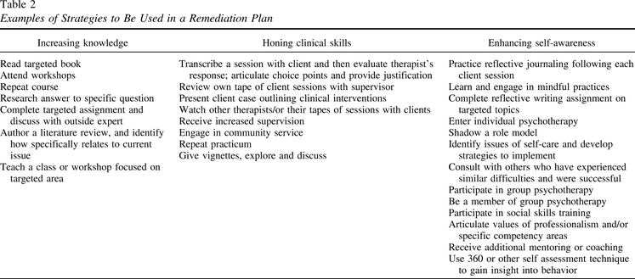

Slide 16
Case: Giselle
Second year doctoral student in clinical psychology
First practicum during 2nd year
1st year no concerns in initial courses
But--- concerns about ability to maintain positive working alliance with three clients
Deficits: empathic reflections, content reflections did not match
Clients did not return or requested a different therapist

Slide 17

What steps would you take for a remediation plan?

Slide 18
Confidentiality vs Privacy
Trainees have the right to privacy
Privacy is the “right to be left alone –freedom from intrusion by others.”
Can be informational, decisional, or physical
Trainers have the obligation to maintain confidentiality
But they also have an obligation to protect the public--gatekeepers

Slide 19
Issues for Trainees
Trainee confidentiality is limited by the profession’s needs to communicate about an individual’s [potential] failure to meet professional standards
Training programs must protect the public
Students expect trainee confidentiality is similar to client confidentiality—but it isn’t
Becoming a professional means students agree to be trained, evaluated and regulated” (Forrest, et al 2022)

Slide 20
Issues for Trainees
” Person/professional boundary is different because the person is so critical in the client-professional relationship—the personal is relevant”
Less central in formative evaluations, but in summative, may be critical
As severity of competence concerns become central, others have to be involved
Training programs involved—not just one faculty, legal involved, administrators, supervisors, too
Concerns about confidentiality of therapy as remediation

Slide 21
Ethical Issues for Trainers
Avoid early discussions (shame, fear of evaluation from peers)
Conflict avoidant
Fear of litigation
resist time to address PCC
Worry about balance between nurturing/advocacy/gatekeeping
Overidentification with students
Need to ensure objectivity

Slide 22
Standards
FERPA—are about written records—but consent is preferable (e.g., ROI to supervisors)
Tensions between Ethics Codes. 2.06, 7.04,

Slide 23
Case: Manuel
Manuel is a third year doctoral student
Struggled during years 1 and 2, but advisor met with him and felt that he helped him address concerns
Concerns included his partner was unhappy with the move for graduate school, unhappy with the time he has to commit to studies, poor pay, lack of contribution to caregiving
Advisor did not tell other faculty about his struggles
By December of year 3, the supervisor and training director of Manuel’s practicum site contacted the training director to say they needed to terminate his practicum, that he had inappropriate boundaries with clients

Slide 24
What steps would you take for a remediation plan?

Slide 25


